Slide 1
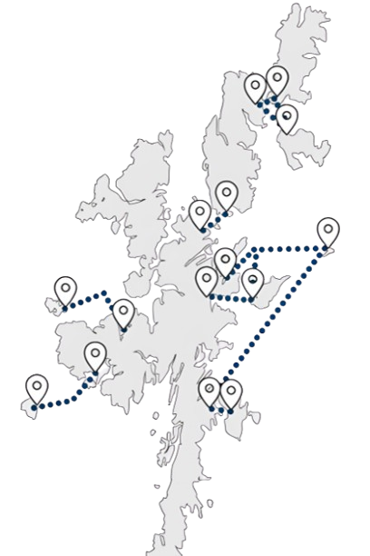











Inter-Island Transport Connectivity Programme
Bressay Public Drop-In Session
1
2
3
  These two elements will be combined to create a ‘Network Strategy’, i.e., a sequential and costed investment plan for the inter-island transport network
We will achieve this by objectively and holistically determining:
The ‘case’ (in its widest sense) for fixed links
The shape of the ferry service and network in the short, medium and long term for all islands
6
This study will set out a long-term plan for Shetland’s island communities
5
The following boards set out:
Business case and decision-making process
Community engagement programme
Headline socio-economic data
Vessel and port profiles
Connectivity
Ferry carryings, capacity utilisation and performance
Resident survey - key headlines
Transport Problems Framework
Next steps and FAQs
4
Following the Strategic Business Case, the
Network Strategy Outline Business Case (OBC) will determine the preferred option for each of the islands and aggregate these to a preferred network option – i.e., which investments should be made, where and in which order?
  The network strategy will be developed in two stages
  Initially, the Network Strategy Strategic Business Case (SBC) will establish the case for investment, the Transport Planning Objectives and the ferry, harbour and, where appropriate, fixed link options at an island level

Slide 2






Network Strategy Strategic Business Case
1
2
3
4
‘Case for Change’
Route level option generation and development
Preliminary Options Appraisal
Programme Level Network Strategy SBC Report
The first step in the process is to set out the ‘Case for Change’ (CfC), which is currently under development. This establishes the rationale for intervention – i.e., why is investment required?
The CfC is being informed by extensive analytical work and engagement with communities, businesses and other stakeholders.
Ferry, harbour and, where appropriate, fixed link options will be outlined for each island. At this stage, all potential options will be included for consideration.
This is primarily a qualitative process, designed to generate a shortlist of options for the detailed options appraisal in the OBC.
This appraisal will be undertaken on a route-by-route basis. A clear rationale for selection or rejection will be provided for all options.
Fixed link proposals for a minimum of Bressay, Fetlar, Unst, Whalsay and Yell will be retained for consideration at OBC.
Council Decision Point 1
‘Sign-off’ by elected Members on the options to be taken forward for detailed appraisal in the Network Strategy OBC.
Network Strategy Outline Business Case
5
6
7
8
Detailed Options Appraisal
Council Decision Point 2
Network options and sequencing
Council Decision Point 3
This part of the business case contains the key quantitative analysis and appraisal, undertaken in accordance with appraisal and business case guidance.
This will include but not be limited to the development of Benefit-Cost Ratios (BCRs), whole life greenhouse gas emissions comparisons, affordability and public acceptability.
Elected Members agree the preferred option for each island to be progressed into the Network Strategy.
Having identified preferred options at the route level, we will develop a range of ‘network option’ scenarios, which consider the timed sequence of investments and the implied costs, benefits and risks.
This will identify the priorities for project-level Outline and Full Business Cases and immediate next steps for the Council.
Preferred network option - elected Members’ sign off on the preferred sequence of investments across the network.
Network Strategy Programme Level OBC

Slide 3









Community Engagement
Network Strategy Engagement and Consultation Programme
1
2
3
4
Case for Change
Options Long List
Conclusion of Detailed Options Appraisal
Network Strategy
Understanding current travel behaviour and any problems with the current ferry service
January to March 2025
Engagement on the individual island options to be progressed to Detailed Options Appraisal
Summer 2025
Engagement on the outcomes of the options appraisal for each island
Winter 2025
Presentation of the final Network Strategy to communities around Council Decision Point 3
Winter 2025
Case for Change Engagement Activities
Online travel behaviour survey
Island resident, under-16 and businesses and mainland resident, under-16 and businesses
Public drop-in sessions
Community Stakeholder/ User Group meetings
Youth engagement
Shetland Youth Voice, 14 January 2025 (with potential for follow-up events)
Scottish and UK Government
Informal liaison at present but a commitment to keep both governments informed
Council in-depth interviews
One-to-one in-depth interviews with officers across different Council services, e.g., Ferries and Economic Development
Stakeholder and business in-depth interviews
One-to-one in-depth interviews with business representative groups, major businesses and organisations that deliver services to the islands
Estate agent interviews
One-to-one in-depth interviews with some estate agents to understand the specifics of the property market in each island

Slide 4













Headline Socio-economic Data
How has population changed over time?
Bressay had a population of 349 at the 2022 Census
Population has been fairly stable over a long time period – this chart shows that:
  Population in 2022 was 4% (15 people) higher than its 1981 level
  Despite this overall long-term stability, population has declined by 10% (35 people) since 2001, which suggests more recent challenges
  The trend in population in Bressay over the last four decades has broadly tracked that of mainland Shetland and the Shetland Islands overall (albeit Bressay’s population rose and then fell, while it was the opposite with the two comparators)
  Bressay has an ageing population relative to mainland Shetland. In 2022:
  The proportion of the population aged 65+ was 30%, compared to only 21% on mainland Shetland
  Perhaps more importantly, Bressay has a smaller proportion of its population aged under-16 (9%) relative to mainland Shetland (19%) – this potentially suggests that families are choosing to live in Lerwick instead
  Bressay’s demographic is however more favourable than in several of Shetland’s other island communities, Fetlar, Unst and Yell for example
What is the economic structure of Bressay?
Wholesale & Retail Trade
The economic structure of Bressay is materially different to Shetland’s other island communities but not dissimilar to Shetland overall. The proximity of the island to Lerwick means that both its economy and services are heavily integrated with those of the town. For example, Bressay no longer has an on-island school or health centre.
Proximity to Lerwick is both advantageous in terms of making a wide range of jobs easily accessible but also a challenge in that it makes developing on-island employment difficult. The absence of a school may have also incentivised parents to leave the island.
In progressing this study, it will be important to ensure that Bressay’s transport connectivity needs are viewed in the wider context of its economic connectedness with Lerwick.
The main island-based employer is the Pelagia Bressay fish factory. There is also a small marina, café and caravan park.
Education
Health & Social Work
Agriculture, Forestry, Fishing
Public Admin & Defence
Transport & Storage
Accommodation and Food Services
Construction
Manufacturing
Arts, Entertainment & Recreation
Administrative and Support Service
Professional, Scientific & Technical Services

Slide 5
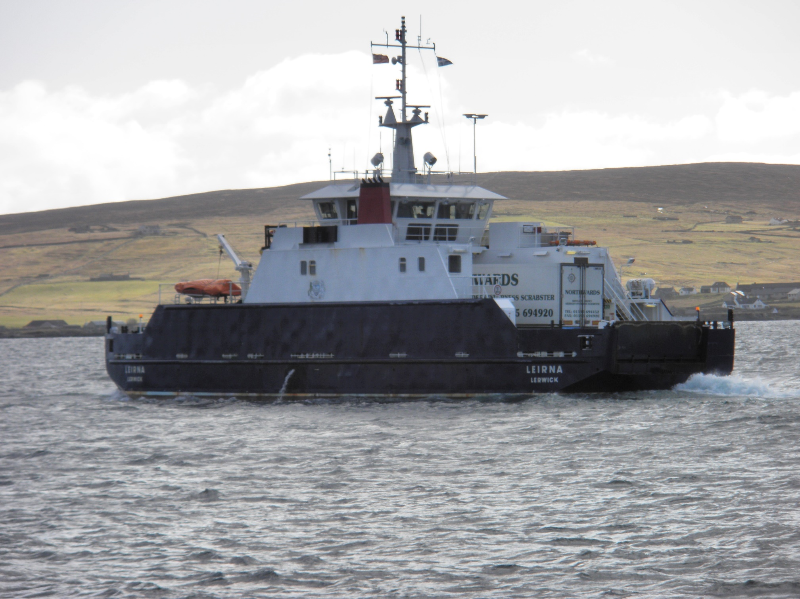
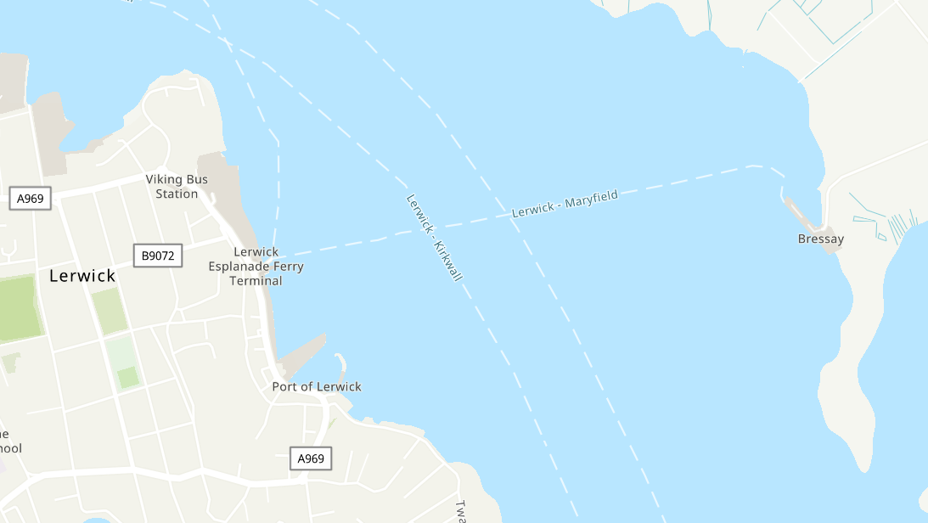
Vessel and Port Profiles
MV Leirna
Entered service: 1992
Passenger capacity (max): 124
Car capacity (Source: SIC): 19
Overnight berth: Bressay
Other points of note:
Ageing vessel which will require replacement in the short – medium term
MV Leirna holds a Class IV certificate and Bressay is therefore the only route in Shetland which she is certified to operate
  The Terminal for the Bressay service in Lerwick is the only one not owned by the Council. It falls with the Lerwick Port Authority (LPA) area and thus the Council pays LPA dues for its use.
  MV Leirna overnights on the linkspan berth in Bressay, which is protected by a breakwater.

Slide 6


Timetable and Connectivity
Timetable is delivered through:
  MV Leirna operating on a ‘shift’-basis. Her first departure from Bressay is 07:00, with her sailing day finishing late in the evening, and early the following morning on a Friday and Saturday
  There are slightly fewer sailings on a Saturday (21) and Sunday (17) relative to a weekday (22 Monday to Thursday and 24 on a Friday)
  During refit, MV Leirna is relieved by the Council’s spare vessel, MV Fivla, which is much smaller, carrying only ten cars
This graphic shows the departure times for scheduled ferry services from both Bressay and Lerwick
Mon
Tue
Wed
Thu
Departing from Bressay to Lerwick
Fri
Sat
Sun
Mon
07:00
08:00
09:00
10:00
11:00
12:00
13:00
14:00
15:00
16:00
17:00
18:00
19:00
20:00
21:00
22:00
23:00
Tue
Wed
Thu
Departing from Lerwick to Bressay
Fri
Sat
Sun
= connecting bus service
There is a very limited bus service on Bressay – this consists of:
No.41 Weekly Shopper – This service runs every Tuesday, picking up from all main roads on Bressay before crossing on the 10:30 ferry and running to Lerwick Tesco and Co-op. The service then runs in the reverse direction, returning on the 14:30 ferry
No.42 – this service operates on a Monday, Wednesday and Friday connecting with the 09:30 and 10:30 ferry departures from Bressay. The return service meets the ferry on the Bressay side of the crossing on the arrival of the 13:00 ferry from Lerwick
The ferry berths in the heart of Lerwick, with the nearby Esplanade bus stops providing onward connections across Shetland.

Slide 7
Ferry Carryings, Capacity Utilisation and Performance
How many sailings are made by each vessel in each year?
The inter-island ferry service was subject to a programme of service reductions in 2013 – for Bressay, the reductions were mainly focused on weekends.
There was an overall 4% reduction in scheduled sailings between 2013 and 2015, and then broad stability thereafter. However, the number of Saturday sailings reduced by 14% and Sunday sailings by 9%.
While frequency was reduced, the length of the operating day was largely maintained.
How have vehicle lane metre carryings changed over time?
The figure shows vehicle carryings in terms of total lane metres (LMs) carried for each year between 2013 and 2024.
A lane metre is a common unit of measurement for all vehicular traffic using a roll-on/roll-off (Ro-Ro) ferry. For example, a typical car would be 5 lane metres.
While carryings on the Bressay route have varied year-on-year, they have been broadly stable overall. Total LMs carried in 2019 were 2% less than in 2013.
When are the busiest sailings?
The chart shows the proportion of Bressay sailings for each scheduled departure time where vehicle deck utilisation exceeded 75% - i.e., sailings which were full or nearly full in 2024.
Capacity is rarely an issue on the Bressay route, with only around 5% of all sailings above this threshold.
However, there are clear peaks on the commuter sailings – 19% of all 10:30 sailings from Bressay and 20% of all 17:15 sailings from Lerwick were above the 75% threshold.
How does this compare across time periods and routes? (2024)
The table on the right shows the proportion of total sailings within given time windows where vehicle deck utilisation exceeded 75% - i.e., sailings which were full or nearly full. It covers all Shetland Ro-Ro routes in the calendar year 2024.
It confirms that capacity is rarely a problem on the Bressay route, outwith certain weekday peak sailings, as indicated above.
 | Tuesday-Friday 0700-1900 | Monday 0700-1900 | Saturday 0800-1900 | Sunday 0900-1800 | Average (7 days, 0700-1900)
Bluemull: Fetlar -Unst | 2.1% | 2.0% | 5.0% | 1.8% | 2.1%
Bluemull: Fetlar-Yell | 2.5% | 3.5% | 4.5% | 4.7% | 2.9%
Bluemull: Unst-Yell | 24.2% | 23.9% | 23.5% | 26.9% | 23.8%
Bressay | 6.0% | 5.5% | 3.7% | 3.2% | 5.2%
Papa Stour | 2.0% | 1.0% | 0.5% | 0.0% | 1.4%
Skerries | 3.9% | 0.7% | 0.9% | 7.1% | 3.4%
Whalsay | 32.8% | 32.8% | 23.2% | 38.1% | 30.8%
Yell Sound | 13.8% | 14.3% | 21.6% | 13.9% | 14.3%
under 5%
5%-15%
more than 15%

Slide 8



Ferry Carryings, Capacity Utilisation and Performance
What was the impact of COVID-19?
The figure shows 2024 carryings as a % of 2019 carryings – i.e., how close has the route got to recovering from COVID-19?
The Bressay route has largely recovered its pre-COVID position, with passenger and car carryings in 2024 standing at 96% and 102% respectively of their pre-pandemic level.
2024 carryings as a proportion of 2019 carryings
Passengers 96%
Cars 102%
CV carryings increased significantly in proportional terms, but 2019 appeared to be an abnormally low year for CV traffic on the route.
Commercial Vehicles (CVs) 205%
How has reliability changed over time?
Available cancellation data are patchy, but it suggests that cancellations are not a significant issue on this route. Only 1%-2% of circa 16,000 sailings are cancelled annually.
Note that the high rate of cancellations in 2020 and possibly 2021 is likely due to crewing issues/self-isolation during the pandemic.
The cause of cancellations is not always systematically recorded.
How many days per year do the services operate to timetable?
The proportion of days when all sailings are operated to timetable (the green line) varies significantly by year. In 2024, all sailings operated to timetable on just under two-thirds of days
However, over 9 in every 10 individual sailings (the blue line) do operate to timetable, so there are high levels of reliability overall
Note that the 2013 % days operating to timetable is an outlier and likely due to anomalies in the raw data

Slide 9

Resident Survey Headlines
All Island Residents
Survey Headlines
Yell
18%
5%
blue badge holders
Car availability is high – 85% have access to a car for personal use
998 responses
Women accounted for 53% of responses
Whalsay
16%
Unst
15%
20%
National Entitlement Card holders
36% of isles employed adults work in mainland Shetland
Bressay
7%
Older age groups (65+) slightly under-represented
Fetlar
3%
Residents’ Use of Ferries
Car/Van (taken onboard, parked or dropped-off) accounts for between 80% and 92% of all ferry trips – with ‘car taken onboard’ the large majority of these
Around 40% of respondents said that there are occasions when they do not try and book because they know the ferry will be full
Unst + Fetlar
6 return trips per month on average
People most often book 2-3 days in advance
Whalsay + Yell
11 trips per month
Of those taking a car onboard, at least 85% of those in Fetlar, Unst, Whalsay and Yell say they book for ‘all or nearly all’ the sailings they make
Around 2/3 of respondents say that there are occasions when they have arrived without booking and have been unable to board the next ferry
15% of respondents said there are occasions when they do not travel at all if they cannot book onto their preferred sailing
Bressay
17 trips per month
Views of ferry services and their impact on island residents
People are typically least satisfied with:
Number of services cancelled at short notice
The service during refit periods
Early / late connections to the airport
Monday timetables (Yell Sound, Bluemull Sound, Whalsay)
Sunday service frequency
Facilities for those with a disability
Top factors limiting off-island travel:
Ability to book a vehicle onto preferred sailing
The number of service cancellations
Weekend service frequency
Activities which are being missed out on include:
Visiting friends and family
Other social activities
Shopping
1/3
of respondents said they travelled off their island less often than they would like because of the current ferry services
These people all noted a desire to travel more frequently if the issues they identified with the ferries were addressed
Mainland Residents
Mainland residents were asked about living in the isles
70% said the ferry service was a factor in their decision to leave
1/3 said they would consider moving back, with improved connectivity a major factor in making that happen
10% of those who have not lived in the isles would consider doing so
  90% of those said improved connectivity would encourage them to do so
1/3 had previously lived in the isles
The survey therefore revealed some appetite to move to/back to the isles if connectivity is improved

Slide 10
Resident Survey – Bressay Headlines
Place of Employment
Main Reason for Journeys
Travel to Ferry
Vehicle Booking onto Ferry
The majority of journeys on this route are made by car - 43% always/mostly take their car on the ferry
A further 33% always/mostly parked their cars at the terminal and travelled on the ferry as a foot passenger
7% of passengers walked to the terminal
Top 5 areas of satisfaction
(total percentage of people who indicate they are either satisfied or very satisfied)
Top 5 areas of dissatisfaction
(total percentage of people who indicate they are either dissatisfied or very dissatisfied)
Number of days per week that service operates [92%]
Crossing time [85%]
The punctuality of service [84%]
Availability of suitable seating [79%]
Connections with NorthLink arrivals and departures [79%]
Ability to catch the first flight [81%]
Level of 10-journey fares: vehicle [69%]
Level of standard fares [68%]
Time of the first sailing of the day [63%]
Level of standard fares: commercial vehicle [53%]

Slide 11
Transport Problems
The case for any transport investment should be based on addressing a set of evidenced transport problems. We have developed a systematic ‘Transport Problems Framework’ to guide the development of this study, which is shown in the figure below.
Step 1
Establish and populate a transport problems framework for the study area
Step 2
Set out the supply-side root cause(s) of each identified problem
Step 3
Set out travel behaviour consequences of these problems
Step 4
Set out the societal consequences of travel behaviour choices
Step 5
Define a Transport Objective reflecting each transport problem(s), or groups of problems
A transport problem can be thought of in one of two ways:
  A problem experienced by a user or potential user of the transport network
  A negative impact imposed by the transport network on communities; poor air quality or noise for example
Transport problems, when thought of in this way, are typically associated with a relatively narrow range of parameters which define any journey, defined here as ‘problem themes’
We have highlighted what we understand to be the main transport problem themes for Bressay in blue in the table on the right. Steps 1 and 2 of the ‘Transport Problems Framework’ are set out in the table below, and the outcomes of this engagement, together with other evidence, will be used to help inform Steps 3-5
All modes of transport | Public transport specific
Concern over the environmental impact of travel | Booking and journey planning
Cost of travel and affordability | Capacity – e.g., car deck capacity
Fuel and power issues | Comfort, safety and security
Integration of travel between modes (e.g., ferry to bus) | Connectivity and network coverage (i.e., availability of services)
Journey information, including for protected groups | Ease of use/convenience
Journey quality | Integration between services (e.g., bus-to-bus)
Journey times | Service reliability (cancellations and punctuality)
Journey time reliability | Timetables (time of first and last service, frequency and days of week operated)
Lack of awareness of travel options
Personal accessibility
Personal security
Travel safety
Problem Theme | Problem(s) | Supply-side cause(s)
Concern over environmental impact of travel | Greenhouse gas emissions from vessels | MV Leirna is a conventional diesel vessel.
Cost of travel and affordability | The level of fares was the major source of resident dissatisfaction identified through the survey | Common fares across all Ro-Ro routes, making the cost per mile for Bressay comparatively high, particularly given the higher frequency of travel on the route.
Integration of travel between modes – ferry to bus | The bus network on Bressay is extremely limited, meaning many people drive and park at the ferry terminal and others take their car on the ferry. | Limited on-island bus network High cost of bus service provision relative to the mainland
Capacity | Capacity overall is not a major problem but between 10% and 20% of 08:30 sailings from Bressay and 17:15 sailings from Lerwick are full or close to full . | Occasional insufficient vehicle deck capacity on these peak sailings
Connectivity and network coverage | Bressay is generally very well-connected for an island of its population, with a relatively frequent service over a long operating day. However, its economic inter-connectedness with Lerwick heightens the need for good transport connectivity. | There is no specific supply-side cause of this problem, rather it reflects the requirement to work around a ferry service to access employment, services etc which are only a very short distance away and on which Bressay depends.
Timetables | The first sailing at 07:00 is relatively late for an island so close to Lerwick and also prevents Bressay residents catching the first flights from Sumburgh without a costly overnight stay. | Current crew rostering
Step 1
Step 2

Slide 12




Questions and Answers
Q. Who is in the programme team?
Shetland Islands Council and advisers:
Stantec – Business case development and overall advisory lead
COWI – Fixed links lead
Mott MacDonald – Ferries and marine infrastructure lead
ProVersa – Supply-chain analysis
Q. Will this study progress a fixed link, ferry or harbour improvements to the point of construction?
No, it will identify a preferred option for each island and the future sequencing of investments (i.e., implementation) across the inter-island network.
Q. What will happen after a preferred option for each island is identified?
Work will commence (subject to funding) on individual, island-specific project business cases for each island’s preferred option, following the programme established by the agreed sequence of investments.
Q. Why is additional project business case work required for each individual island’s preferred option?
There are certain aspects about the viability, affordability and deliverability of each island’s preferred option that are typically managed more efficiently as individual projects. For example:
The development of detailed design proposals that take account of the constraints, risks and conditions for each individual project
Ground investigations for individual projects will be costly and, therefore, this expenditure should only be committed when required for individual projects
The identification of a procurement strategy that, while delivering best value to Shetland, is realistically achievable by the market in terms of capacity and experience
In addition, well-structured business cases are usually the key to positive funding decisions.
Q. Who makes the final decision on which project(s) goes ahead?
Decisions will be made by Shetland Island Council elected Members at three key decision points:
Decision Point 1 – the options to be taken forward for detailed appraisal
Decision Point 2 – preferred option for each island
Decision Point 3 – preferred sequence (and programme) of investments across the network, i.e., which individual projects are prioritised for delivery
These decisions will be evidence-led and informed by analytical work based on guidance adopted by the Scottish and UK Governments, as well as further consultation and community engagement.
Q. When will I next be engaged with on this project?
We anticipate that the next round of engagement will take place in late Summer 2025. We will engage on the range of available options – ferry, harbour and fixed links – for each individual island and which of them should be taken forward for more detailed appraisal. This will support elected Members’ considerations at Decision Point 1.

Slide 13
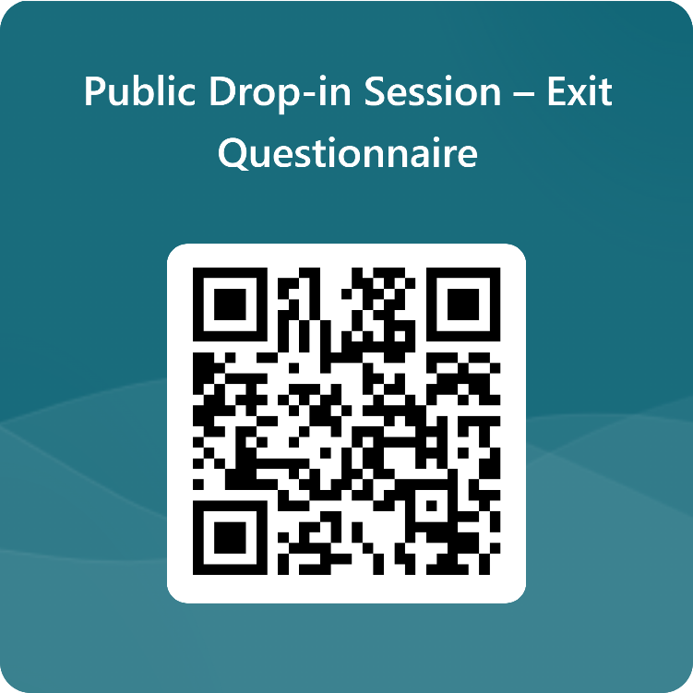
Next Steps
How will the outputs of this drop-in session be used?
The ‘case for change’ (or investment) is founded on the transport problems identified
These are used as the basis for setting out the ‘Transport Planning Objectives’, which are effectively a statement of the outcome sought from any investment and are used to appraise options
The discussions today, together with the outputs from the feedback forms, will be added to the wider body of evidence that we are developing to support the ‘case for change’
These will also allow us to sense check the data that we have presented, ensuring that it reflects the reality experienced by Bressay residents when making journeys
What to do next
Please take this opportunity to provide your thoughts to the team on the material presented and ask any questions you may have
Does the information presented align with your experience of using the Bressay ferry services?
The boards that you have just read provide some topics that you may wish to discuss, and we would be happy to hear any views that you may have
The display boards will also be published online at: www.shetland.gov.uk/iiTCShetland
Please also take the time to fill out the feedback form before you leave. It can also be found here: https://forms.office.com/r/zNbZDm7x8q

