Slide 1
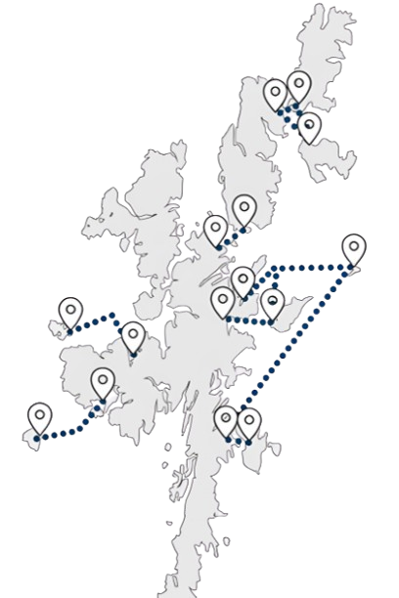











Inter-Island Transport Connectivity Programme
Yell Public Drop-In Session
1
2
3
  These two elements will be combined to create a ‘Network Strategy’, i.e., a sequential and costed investment plan for the inter-island transport network
We will achieve this by objectively and holistically determining:
The ‘case’ (in its widest sense) for fixed links
The shape of the ferry service and network in the short, medium and long term for all islands
6
This study will set out a long-term plan for Shetland’s island communities
5
The following boards set out:
Business case and decision-making process
Community engagement programme
Headline socio-economic data
Vessel and port profiles
Connectivity
Ferry carryings, capacity utilisation and performance
Resident survey - key headlines
Transport Problems Framework
Next steps and FAQs
Note that the route data presented is for Yell Sound. Information on the Gutcher – Belmont – Hamars Ness route is provided in booklet form around the room
4
Following the Strategic Business Case, the
Network Strategy Outline Business Case (OBC) will determine the preferred option for each of the islands and aggregate these to a preferred network option – i.e., which investments should be made, where and in which order?
  The network strategy will be developed in two stages
  Initially, the Network Strategy Strategic Business Case (SBC) will establish the case for investment, the Transport Planning Objectives and the ferry, harbour and, where appropriate, fixed link options at an island level

Slide 2






Network Strategy Strategic Business Case
1
2
3
4
‘Case for Change’
Route level option generation and development
Preliminary Options Appraisal
Programme Level Network Strategy SBC Report
The first step in the process is to set out the ‘Case for Change’ (CfC), which is currently under development. This establishes the rationale for intervention – i.e., why is investment required?
The CfC is being informed by extensive analytical work and engagement with communities, businesses and other stakeholders.
Ferry, harbour and, where appropriate, fixed link options will be developed for each island. At this stage, all potential options will be included for consideration.
This is primarily a qualitative process, designed to generate a shortlist of options for the detailed options appraisal in the OBC.
This appraisal will be undertaken on a route-by-route basis. A clear rationale for selection or rejection will be provided for all options.
Fixed link proposals for a minimum of Bressay, Fetlar, Unst, Whalsay and Yell will be retained for consideration at OBC.
Council Decision Point 1
‘Sign-off’ by elected Members on the options to be taken forward for detailed appraisal in the Network Strategy OBC.
Network Strategy Outline Business Case
5
6
7
8
Detailed Options Appraisal
Council Decision Point 2
Network options and sequencing
Council Decision Point 3
This part of the business case contains the key quantitative analysis and appraisal, undertaken in accordance with appraisal and business case guidance.
This will include but not be limited to the development of Benefit-Cost Ratios (BCRs), whole life greenhouse gas emissions comparisons, affordability and public acceptability.
Elected Members agree the preferred option for each island to be progressed into the Network Strategy.
Having identified preferred options at the route level, we will develop a range of ‘network option’ scenarios, which consider the timed sequence of investments and the implied costs, benefits and risks.
This will identify the priorities for project-level Outline and Full Business Cases and immediate next steps for the Council
Preferred network option –elected Members’ sign off on the preferred sequence of investments across the network
Network Strategy Programme Level OBC

Slide 3









Community Engagement
Network Strategy Engagement and Consultation Programme
1
2
3
4
Case for Change
Options Long List
Conclusion of Detailed Options Appraisal
Network Strategy
Understanding current travel behaviour and any problems with the current ferry service
January to March 2025
Engagement on the individual island options to be progressed to Detailed Options Appraisal
Summer 2025
Engagement on the outcomes of the options appraisal for each island
Winter 2025
Presentation of the final Network Strategy to communities around Council Decision Point 3
Winter 2025
Case for Change Engagement Activities
Online travel behaviour survey
Island resident, under-16 and businesses and mainland resident, under-16 and businesses
Public drop-in sessions
Community Stakeholder/User Group meetings
Youth engagement
Shetland Youth Voice, 14 January 2025 (with potential for follow-up events)
Scottish and UK Government
Informal liaison at present but a commitment to keep both governments informed
Council in-depth interviews
One-to-one in-depth interviews with officers across different Council services, e.g., Ferries and Economic Development
Stakeholder and business in-depth interviews
One-to-one in-depth interviews with business representative groups, major businesses and organisations that deliver services to the islands
Estate agent interviews
One-to-one in-depth interviews with some estate agents to understand the specifics of the property market in each island

Slide 4












Headline Socio-economic Data
How has population changed over time?
Yell had a population of 897 at the 2022 Census
The island’s population has however been on a long-term downward trend – the chart shows that:
  Yell’s population has reduced by one quarter since 1981 – this is a very stark reduction over a relatively short period in demographic terms
  This reduction contrasts with a picture of stability for the Shetland Islands overall, and modest growth in mainland Shetland, but reflects a wider issue population loss in the North Isles (Fetlar, Unst and Yell)
  Unlike neighbouring Unst, where the population stabilised between the 2011 and 2022 Census periods, Yell’s population has continued on a downward trend, reducing by 7% between 2011 and 2022.
  Yell has an ageing population relative to mainland Shetland, and indeed Shetland overall. In 2022:
  The proportion of the population aged 65+ was 30%, compared to only 21% on mainland Shetland
  The proportion of under-16s in Yell (14%) was relatively low compared to mainland Shetland (19%) and the Shetland Islands overall (18%)
  Yell’s ageing population has implications for service delivery on the island, the ability to fill island jobs and for resident travel demand.
What is the economic structure of Yell?
Like many of Shetland’s island communities, Yell has an above average concentration of resident employment (i.e., jobs filled by island residents irrespective of whether they work in Yell) in ‘Agriculture, Forestry and Fishing’ (17%). The island has a strong presence in the aquaculture and shellfish sectors in particular, as well as a fish processing plant at Cullivoe.
The economy is otherwise relatively mixed with, for example, public sector employment at Mid Yell Junior High School and growing renewable energy production
There are several major opportunities for Yell at present, including further development of the renewable energy sector and commercial kelp production
  Commuting to jobs off-island is though essential:
    19% of all Yell adults in employment travel over 20km to work, which implies that they work off-island
    A further 15% responded ‘Other’ with respect to their distance travelled to work – this is likely to combine working at sea/offshore and potentially staying off-island for the week (e.g., staying Monday to Friday in Lerwick, although this will likely be less prominent than for Unst and Fetlar, which are more distant)
    Levels of car ownership are not dissimilar to the Shetland average
Agriculture, Forestry, Fishing
Health & Social Work
Transport & Storage
Education
Manufacturing
Wholesale & Retail Trade
Public Admin & Defence
Construction
Administrative and Support Service
Arts, Entertainment & Recreation
Professional, Scientific & Technical Services

Slide 5
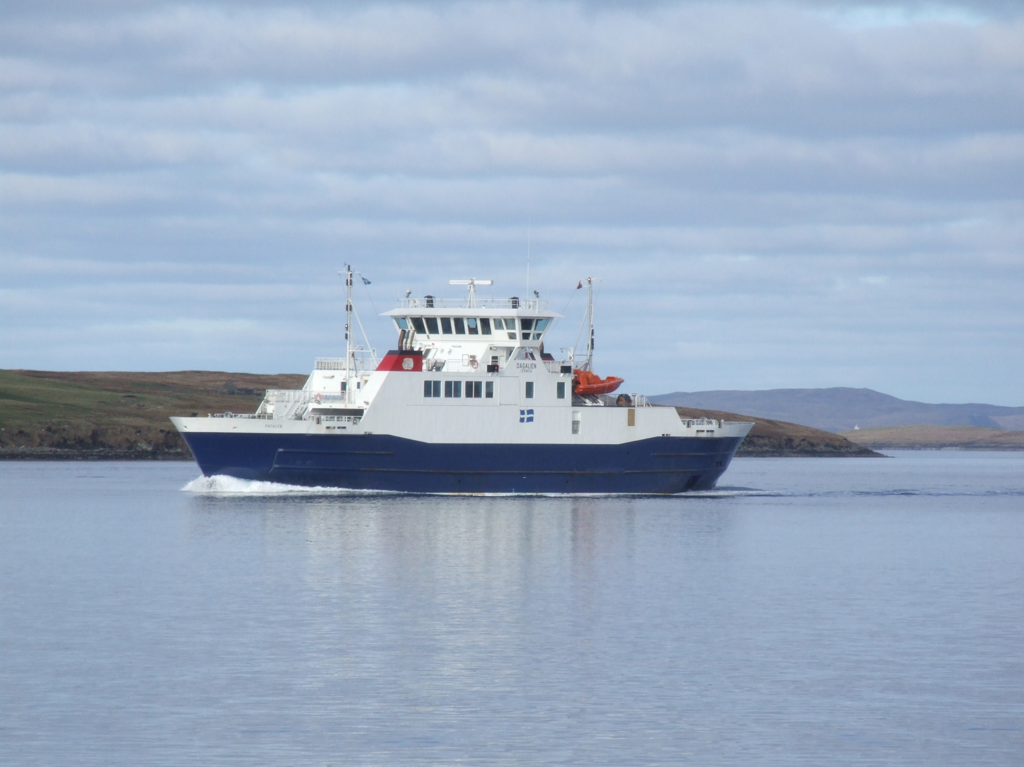
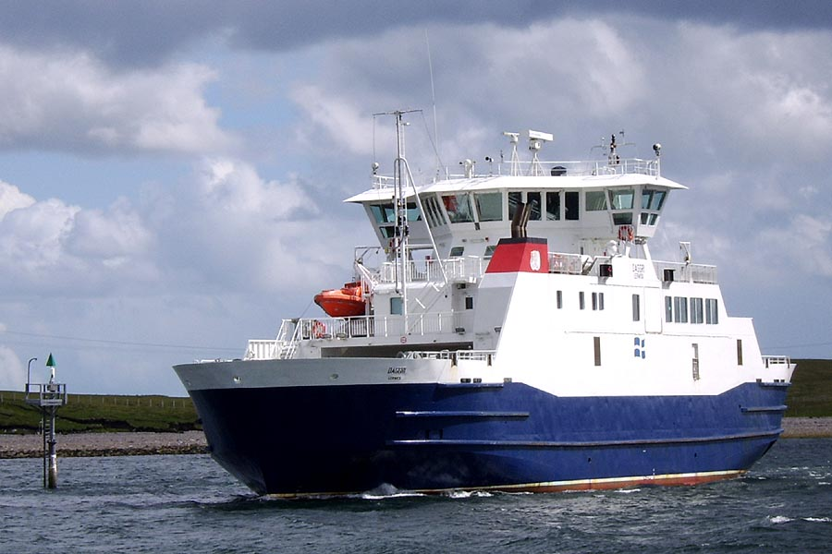
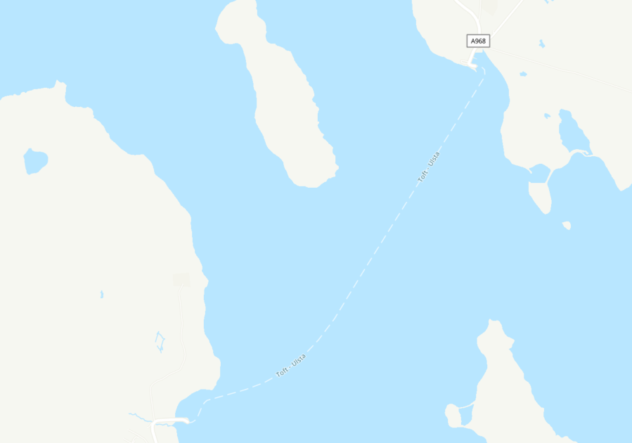
Vessel and Port Profiles
MV Dagalien
Entered service: 2004
Passenger capacity (max): 144
Car capacity (Source: SIC): 31
Overnight berth: Ulsta
Other points of note – MV Dagalien and MV Daggri are sister ships built specifically for the Yell Sound route – they are the largest vessels in the fleet and therefore cannot routinely serve any other Shetland linkspans except Hamars Ness, Fetlar
MV Daggri
Entered service: 2004
Passenger capacity (max): 144
Car capacity (Source: SIC): 31
Overnight berth: Ulsta
Ulsta
Island port for the Yell Sound route.
Both MV Dagalien and MV Daggri overnight at Ulsta, with the shift vessel overnighting on the linkspan berth and the day vessel on the layby berth
Toft
  Mainland Shetland port for the Yell Sound route.

Slide 6


Timetable and Connectivity
Timetable is delivered through:
  As sister vessels, MV Dagalien and MV Daggri are entirely interchangeable
  One vessel operates on a ‘shift’ basis, sailing from 06:15 through to 23:40 seven days a week. The last return sailing is on request only
  The second vessel is the ‘day boat’, operating from 07:45 to 17:40 Monday to Friday
  The route is operated by a single vessel on a Saturday and Sunday
Winter and summer timetables are broadly the same
Most recent refit period (2025) saw a reduction to a single vessel – major reduction in weekday connectivity
Service reduces to a single vessel for a period on a Monday to allow for drills and maintenance
Yell Sound operated with two vessels on a Saturday prior to the 2013 service reductions. The switch to a single vessel service represented a significant reduction in connectivity for Yell residents (and also those of Fetlar and Unst)
This graphic shows the departure times for scheduled ferry services from both Ulsta and Toft
Mon
*
Tue
*
Wed
*
Departing from Ulsta to Toft
*
Thu
Fri
*
Sat
*
Sun
*
Mon
06:00
07:00
08:00
09:00
10:00
11:00
12:00
13:00
14:00
15:00
16:00
17:00
18:00
19:00
20:00
21:00
22:00
23:00
*
Tue
*
Wed
*
Departing from Toft to Ulsta
Thu
*
Fri
*
Sat
*
Sun
*
= connecting bus service from Toft
* = request sailing
  The No.23 bus connects Lerwick (Viking Bus Station) with Toft
  On a weekday, there are six buses from Lerwick to Toft and seven from Toft to Lerwick (six on non-school days)
  There are also six services in each direction on a Saturday, with no connecting buses on a Sunday
  The end-to-end journey time is around one hour
  The No.24 bus provides a through bus service from Gutcher (the embarkation point for the ferry to Fetlar and Unst) to Lerwick via the Yell Sound ferry. This is a single return service per day (Monday to Friday) which:
  Departs Gutcher at 08:40 (the bus actually starts at Greenbank at 08:20), travels on the 09:15 sailing from Ulsta and arrives in Lerwick at 10:26
  In the reverse direction, the bus leaves Lerwick at 14:20, travels on the 15:25 sailing from Toft and arrives in Gutcher at 16:12
  On Yell, the No.24Y bus/dial-a-ride (Cullivoe to Ulsta) provides a public transport connection to the Yell Sound ferry
  There are three buses per day in each direction Monday to Saturday (there is an additional Ulsta – Cullivoe service on a Friday, four in total)
  There are no connecting buses on a Sunday
  The end-to-end journey time is just over 40 minutes

Slide 7
Ferry Carryings, Capacity Utilisation and Performance
How many sailings are made by each vessel in each year?
The inter-island ferry service was subject to a programme of service reductions from 2013 – for Yell, the reductions were mainly focused on Saturdays.
There was a 6% reduction in scheduled sailings between 2013 and 2015, and then broad stability thereafter.
Saturday sailings reduced by 23% between 2013 and 2015 due to the route being operated by the shift vessel only.
How have vehicle lane metre carryings changed over time?
The figure shows vehicle carryings in terms of total lane metres (LMs) carried for each year between 2013 and 2023 .
A lane metre is a common unit of measurement for all vehicular traffic using a roll-on/roll-off (Ro-Ro) ferry. For example, a typical car would be 5 lane metres.
There was strong growth in carryings pre-pandemic, with total LMs up by 18% in 2019 relative to 2013, despite the 6% reduction in sailings.
When are the busiest sailings?
The chart shows the proportion of sailings for each timetabled departure time in 2024 where the vehicle deck sailing was over 75% utilised – i.e., where the sailing was full or nearly full.
With the exception of the 07:45 from Toft, the majority of busier sailings were late morning and in the middle of the day.
Sailings after 19:00 are very lightly utilised.
How does this compare across time periods and routes? (2024)
The table on the right shows the proportion of total sailings within given time windows where vehicle deck utilisation exceeded 75% – i.e., sailings which were full or nearly full. It covers all Shetland Ro-Ro routes in the calendar year 2024 for comparative purposes
Key headlines for Yell include:
Nearly 15% of weekday sailings between 07:00-19:00 are full or nearly full
Utilisation is higher on a Monday due to the reduction of the service to a single vessel in the middle of the day
Saturday is the most capacity constrained day on Yell Sound – the single vessel service means that over a fifth of all sailings are full or nearly full
The single vessel service on a Sunday also leads to 14% of sailings being full or nearly full
 | Tuesday-Friday 0700-1900 | Monday 0700-1900 | Saturday 0800-1900 | Sunday 0900-1800 | Average (7 days, 0700-1900)
Bluemull: Fetlar -Unst | 2.1% | 2.0% | 5.0% | 1.8% | 2.1%
Bluemull: Fetlar-Yell | 2.5% | 3.5% | 4.5% | 4.7% | 2.9%
Bluemull: Unst-Yell | 24.2% | 23.9% | 23.5% | 26.9% | 23.8%
Bressay | 6.0% | 5.5% | 3.7% | 3.2% | 5.2%
Papa Stour | 2.0% | 1.0% | 0.5% | 0.0% | 1.4%
Skerries | 3.9% | 0.7% | 0.9% | 7.1% | 3.4%
Whalsay | 32.8% | 32.8% | 23.2% | 38.1% | 30.8%
Yell Sound | 13.8% | 14.3% | 21.6% | 13.9% | 14.3%
under 5%
5%-15%
more than 15%

Slide 8



Ferry Carryings, Capacity Utilisation and Performance
What was the impact of COVID-19?
2024 carryings as a proportion of 2019 carryings
The figure shows 2024 carryings as a % of 2019 carryings – i.e., how close has the route got to recovering from COVID-19?
The Yell Sound route has recovered its pre-COVID position, with passenger and car carryings in 2024 standing at 97% and 101% respectively of their pre-pandemic level.
CV carryings have also recovered their pre-pandemic level.
Passengers 97%
Cars 101%
Commercial Vehicles (CVs) 103%
How has reliability changed over time?
Available cancellation data are patchy but suggest that the number of cancellations on Yell Sound has been broadly stable over time. However, there was a sharp increase in cancellations in 2024, accounting for one-in-ten sailings.
Cancellations in 2020 and 2021 were likely influenced by the pandemic (e.g., requirement of crew to self-isolate).
The cause of cancellations is not always systematically recorded.
How many days per year do the services operate to timetable?
The proportion of days when all sailings operated to timetable (the green line) varies significantly by year. In 2024, all sailings operated to timetable on two thirds of days
However, around 9 in every 10 individual sailings (the blue line) operate to timetable, so there are high levels of reliability overall

Slide 9

Resident Survey Headlines
All Island Residents
Survey Headlines
Yell
18%
5%
blue badge holders
Car availability is high – 85% have access to a car for personal use
998 responses
Women accounted for 53% of responses
Whalsay
16%
Unst
15%
20%
National Entitlement Card holders
36% of isles employed adults work in mainland Shetland
Bressay
7%
Older age groups (65+) slightly under-represented
Fetlar
3%
Residents’ Use of Ferries
Car/Van (taken onboard, parked or dropped-off) accounts for between 80% and 92% of all ferry trips – with ‘car taken onboard’ the large majority of these
Around 40% of respondents said that there are occasions when they do not try and book because they know the ferry will be full
Unst + Fetlar
6 return trips per month on average
People most often book 2-3 days in advance
Whalsay + Yell
11 trips per month
Of those taking a car onboard, at least 85% of those in Fetlar, Unst, Whalsay and Yell say they book for ‘all or nearly all’ the sailings they make
Around 2/3 of respondents say that there are occasions when they have arrived without booking and have been unable to board the next ferry
15% of respondents said there are occasions when they do not travel at all if they cannot book onto their preferred sailing
Bressay
17 trips per month
Views of ferry services and their impact on island residents
People are typically least satisfied with:
Number of services cancelled at short notice
The service during refit periods
Early / late connections to the airport
Monday timetables (Yell Sound, Bluemull Sound, Whalsay)
Sunday service frequency
Facilities for those with a disability
Top factors limiting off-island travel:
Ability to book a vehicle onto preferred sailing
The number of service cancellations
Weekend service frequency
Activities which are being missed out on include:
Visiting friends and family
Other social activities
Shopping
1/3
of respondents said they travelled off their island less often than they would like because of the current ferry services
These people all noted a desire to travel more frequently if the issues they identified with the ferries were addressed
Mainland Residents
Mainland residents were asked about living in the isles
70% said the ferry service was a factor in their decision to leave
1/3 said they would consider moving back, with improved connectivity a major factor in making that happen
10% of those who have not lived in the isles would consider doing so
  90% of those said improved connectivity would encourage them to do so
1/3 had previously lived in the isles
The survey therefore revealed some appetite to move to/back to the isles if connectivity is improved

Slide 10
Resident Survey – Yell Headlines
Place of Employment
Main Reason for Journeys
Travel to Ferry
Vehicle Booking onto Ferry
The following sailings were identified as the ‘top 3’ most essential to book when travelling from Ulsta
09:15 (19%)
08:15 (12%)
07:05 (11%)
The majority of journeys on this route are made by car –
82% always/mostly take their car on the ferry
A further 7% always/mostly parked their cars at the terminal and travelled on the ferry as a foot passenger
5% of passengers take a commercial vehicle onboard
The following sailings were identified as the ‘top 3’ most essential to book when travelling from Toft
17:30 (11%)
16:55 (9%)
13:55 (9%)
In a typical month, how often are you unable to book onto your intended sailing?
If you cannot book onto your preferred sailing, what do you usually do
Top 5 areas of satisfaction
(total percentage of people who indicate they are either satisfied or very satisfied)
Top 5 areas of dissatisfaction
(total percentage of people who indicate they are either dissatisfied or very dissatisfied)
Availability of suitable seating onboard [78%]
Comfort onboard [76%]
The ease and convenience of the booking process [72%]
Crossing time [72%]
Number of days per week ferry operates [69%]
Service during vessel refit period [75%]
The number of service cancellations (short notice) [75%]
Ability to catch the first flight [66%]
The number of service cancellations (in advance) [63%]
Monday timetables [59%]

Slide 11
Transport Problems
The case for any transport investment should be based on addressing a set of evidenced transport problems. We have developed a systematic ‘Transport Problems Framework’ to guide the development of this study, which is shown in the figure below.
Step 1
Establish and populate a transport problems framework for the study area
Step 2
Set out the supply-side root cause(s) of each identified problem
Step 3
Set out travel behaviour consequences of these problems
Step 4
Set out the societal consequences of travel behaviour choices
Step 5
Define a Transport Objective reflecting each transport problem(s), or groups of problems
A transport problem can be thought of in one of two ways:
  A problem experienced by a user or potential user of the transport network
  A negative impact imposed by the transport network on communities; poor air quality or noise for example
Transport problems, when thought of in this way, are typically associated with a relatively narrow range of parameters which define any journey, defined here as ‘problem themes’
We have highlighted what we understand to be the main transport problem themes for Yell in blue in the table on the right. Steps 1 and 2 of the ‘Transport Problems Framework’ are set out in the table below, and the outcomes of this engagement, together with other evidence, will be used to help inform Steps 3-5
All modes of transport | Public transport specific
Concern over the environmental impact of travel | Booking and journey planning
Cost of travel and affordability | Capacity – e.g., car deck capacity
Fuel and power issues | Comfort, safety and security
Integration of travel between modes (e.g., ferry to bus) | Connectivity and network coverage (i.e., availability of services)
Journey information, including for protected groups | Ease of use/convenience
Journey quality | Integration between services (e.g., bus-to-bus)
Journey times | Service reliability (cancellations and punctuality)
Journey time reliability | Timetables (time of first and last service, frequency and days of week operated)
Lack of awareness of travel options
Personal accessibility
Personal security
Travel safety
Problem Theme | Problem(s) | Supply-side cause(s)
Concern over environmental impact of travel | Greenhouse gas emissions from vessels | MV Dagalien and MV Daggri are both conventional diesel vessels
Cost of travel and affordability | The level of fares was a source of dissatisfaction in the resident survey | High-frequency of travel means that the cost of travel can account for a high proportion of income
Integration of travel between modes – ferry to bus | Majority of ferries to from Toft/Ulsta do not connect with a bus | Limited and fragmented bus network High cost of bus service provision relative to demand
Booking and journey planning | Most Yell residents have to book sailings when taking a car – may not be able to get booking on preferred sailing and general ‘hassle factor’ | High vehicle deck utilisation on peak sailings, booking required to guarantee travel Issue at the weekend when the route is operated by a single vessel
Capacity | Inability to secure a place on the ferry, either unable to get a booking or travel on demand when unbooked | Insufficient vehicle deck capacity on some sailings, but a particular problem on a Saturday Little alternative to taking the car given the limited bus network
Service reliability (cancellations and punctuality) | 63% of Yell residents are unhappy with advance cancellations and 75% with short notice cancellations | Understood to be issues around crew availability/breakdowns rather than weather
Timetables | One vessel service in the middle of the day on a Monday and all day on a Saturday and Sunday – lower frequency Connections with first and last flights from Sumburgh One vessel service during refit | Monday late morning/early afternoon used for drills and maintenance Limited resilience in fleet to cover refit Cost and crewing implications of operating the second vessel on a Saturday/at the weekend
Step 1
Step 2

Slide 12




Questions and Answers
Q. Who is in the programme team?
Shetland Islands Council and advisers:
Stantec – Business case development and overall advisory lead
COWI – Fixed links lead
Mott MacDonald – Ferries and marine infrastructure lead
ProVersa – Supply-chain analysis
Q. Will this study progress a fixed link, ferry or harbour improvements to the point of construction?
No, it will identify a preferred option for each island and the future sequencing of investments (i.e., implementation) across the inter-island network.
Q. What will happen after a preferred option for each island is identified?
Work will commence (subject to funding) on individual, island-specific project business cases for each island’s preferred option, following the programme established by the agreed sequence of investments.
Q. Why is additional project business case work required for each individual island’s preferred option?
There are certain aspects about the viability, affordability and deliverability of each island’s preferred option that are typically managed more efficiently as individual projects. For example:
The development of detailed design proposals that take account of the constraints, risks and conditions for each individual project
Ground investigations for individual projects will be costly and, therefore, this expenditure should only be committed when required for individual projects
The identification of a procurement strategy that, while delivering best value to Shetland, is realistically achievable by the market in terms of capacity and experience
In addition, well-structured business cases are usually the key to positive funding decisions.
Q. Who makes the final decision on which project(s) goes ahead?
Decisions will be made by Shetland Islands Council elected Members at three key decision points:
Decision Point 1 – the options to be taken forward for detailed appraisal
Decision Point 2 – preferred option for each island
Decision Point 3 – preferred sequence (and programme) of investments across the network, i.e., which individual projects are prioritised for delivery
These decisions will be evidence-led and informed by analytical work based on guidance adopted by the Scottish and UK Governments, as well as further consultation and community engagement.
Q. When will I next be engaged with on this project?
We anticipate that the next round of engagement will take place in late Summer 2025. We will engage on the range of available options – ferry, harbour and fixed links – for each individual island and which of them should be taken forward for more detailed appraisal. This will support elected Members’ considerations at Decision Point 1.

Slide 13
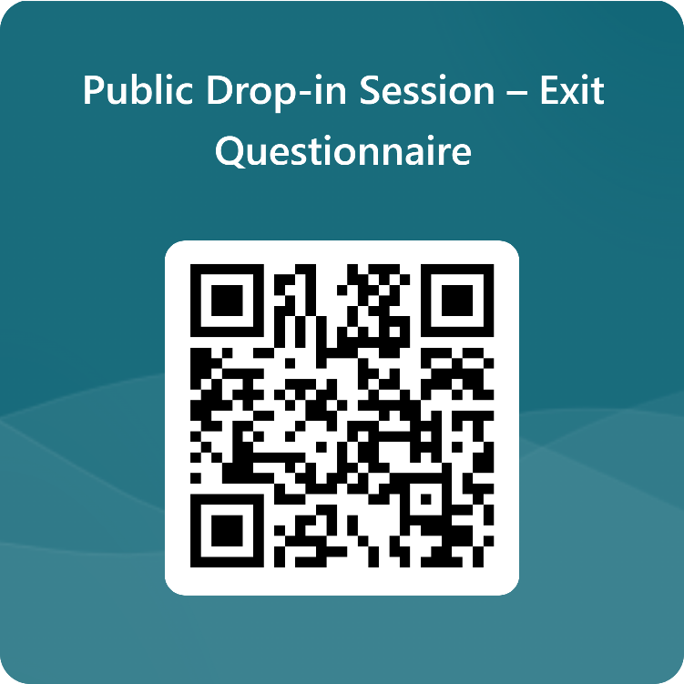
Next Steps
How will the outputs of this drop-in session be used?
The ‘case for change’ (or investment) is founded on the transport problems identified
These are used as the basis for setting out the ‘Transport Planning Objectives’, which are effectively a statement of the outcome sought from any investment and are used to appraise options
The discussions today, together with the outputs from the feedback forms, will be added to the wider body of evidence that we are developing to support the ‘case for change’
They will also allow us to sense check the data that we have presented, ensuring that it reflects the reality experienced by Yell residents when making journeys
What to do next
Please take this opportunity to provide your thoughts to the team on the material presented and ask any questions you may have
Does the information presented align with your experience of using the Yell ferry services?
The boards that you have just read provide some topics that you may wish to discuss, and we would be happy to hear any views that you may have
The display boards will also be published online at: www.shetland.gov.uk/iiTCShetland
Please also take the time to fill out the feedback form before you leave. It can also be found here: https://forms.office.com/r/zNbZDm7x8q

