Slide 1
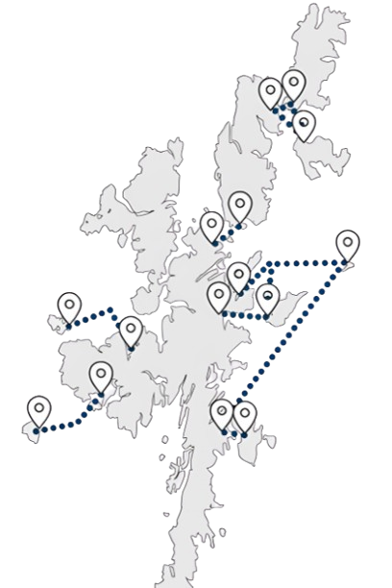











Inter-Island Transport Connectivity Programme
Fetlar Public Drop-In Session
1
2
3
  These two elements will be combined to create a ‘Network Strategy’, i.e., a sequential and costed investment plan for the inter-island transport network
We will achieve this by objectively and holistically determining:
The ‘case’ (in its widest sense) for fixed links
The shape of the ferry service and network in the short, medium and long term for all islands
6
This study will set out a long-term plan for Shetland’s island communities
5
The following boards set out:
Business case and decision-making process
Community engagement programme
Headline socio-economic data
Vessel and port profiles
Connectivity
Ferry carryings, capacity utilisation and performance
Resident survey - key headlines
Transport Problems Framework
Next steps and FAQs
Note that the route data presented is for Hamars Ness – Belmont / Gutcher. Information on the Yell Sound route is presented in booklet format around the room
4
Following the Strategic Business Case, the
Network Strategy Outline Business Case (OBC) will determine the preferred option for each of the islands and aggregate these to a preferred network option – i.e., which investments should be made, where and in which order?
  The network strategy will be developed in two stages
  Initially, the Network Strategy Strategic Business Case (SBC) will establish the case for investment, the Transport Planning Objectives and the ferry, harbour and, where appropriate, fixed link options at an island level

Slide 2

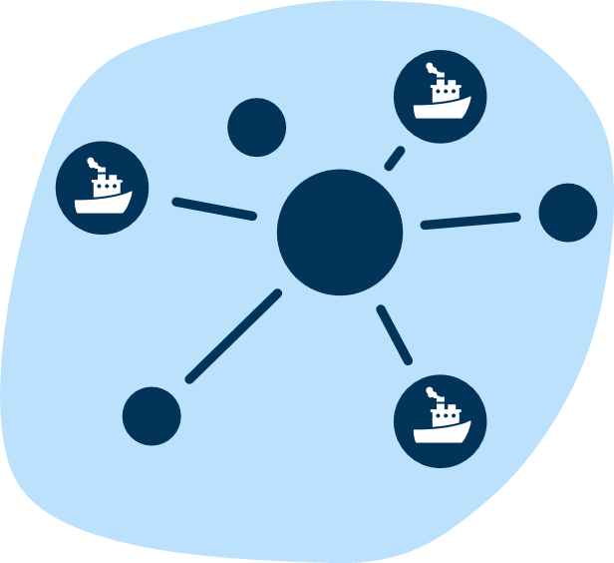




Network Strategy Strategic Business Case
1
2
3
4
‘Case for Change’
Route level option generation and development
Preliminary Options Appraisal
Programme Level Network Strategy SBC Report
The first step in the process is to set out the ‘Case for Change’ (CfC), which is currently under development. This establishes the rationale for intervention – i.e., why is investment required?
The CfC is being informed by extensive analytical work and engagement with communities, businesses and other stakeholders.
Ferry, harbour and, where appropriate, fixed link options will be outlined for each island. At this stage, all potential options will be included for consideration.
This is primarily a qualitative process, designed to generate a shortlist of options for the detailed options appraisal in the OBC.
This appraisal will be undertaken on a route-by-route basis. A clear rationale for selection or rejection will be provided for all options.
Fixed link proposals for a minimum of Bressay, Fetlar, Unst, Whalsay and Yell will be retained for consideration at OBC.
Council Decision Point 1
‘Sign-off’ by elected Members on the options to be taken forward for detailed appraisal in the Network Strategy OBC.
Network Strategy Outline Business Case
5
6
7
8
Detailed Options Appraisal
Council Decision Point 2
Network options and sequencing
Council Decision Point 3
This part of the business case contains the key quantitative analysis and appraisal, undertaken in accordance with appraisal and business case guidance.
This will include but not be limited to the development of Benefit-Cost Ratios (BCRs), whole life greenhouse gas emissions comparisons, affordability and public acceptability.
Elected Members agree the preferred option for each island to be progressed into the Network Strategy.
Having identified preferred options at the route level, we will develop a range of ‘network option’ scenarios, which consider the timed sequence of investments and the implied costs, benefits and risks.
This will identify the priorities for project-level Outline and Full Business Cases and immediate next steps for the Council
Preferred network option - elected Members’ sign-off on the preferred sequence of investments across the network
Network Strategy Programme Level OBC

Slide 3









Community Engagement
Network Strategy Engagement and Consultation Programme
1
2
3
4
Case for Change
Options Long List
Conclusion of Detailed Options Appraisal
Network Strategy
Understanding current travel behaviour and any problems with the current ferry service
January to March 2025
Engagement on the individual island options to be progressed to Detailed Options Appraisal
Summer 2025
Engagement on the outcomes of the options appraisal for each island
Winter 2025
Presentation of the final Network Strategy to communities around Council Decision Point 3
Winter 2025
Case for Change Engagement Activities
Online travel behaviour survey
Island resident, under-16 and businesses and mainland resident, under-16 and businesses
Public drop-in sessions
Community Stakeholder/User Group meetings
Youth engagement
Shetland Youth Voice, 14 January 2025 (with potential for follow-up events)
Scottish and UK Government
Informal liaison at present but a commitment to keep both governments informed
Council in-depth interviews
One-to-one in-depth interviews with Officers across different Council services, e.g., Ferries and Economic Development
Stakeholder and business in-depth interviews
One-to-one in-depth interviews with business representative groups, major businesses and organisations that deliver services to the islands
Estate agent interviews
One-to-one in-depth interviews with some estate agents to understand the specifics of the property market in each island

Slide 4








Headline Socio-economic Data
How has population changed over time?
Fetlar had a population of 66 at the 2022 Census
The population of the island has however been on a long-term downward trend – the chart shows that population in 2022 was 65% of its 1981 level. This reduction contrasts with a picture of broad stability for the Shetland Islands overall, and modest growth in mainland Shetland
The population of Fetlar did however stabilise between the 2011 and 2022 Census periods
  Fetlar has an ageing population relative to mainland Shetland, and indeed Shetland overall. In 2022:
  The proportion of the population aged 65+ was 35%, compared to only 21% on mainland Shetland. Indeed, Fetlar has the highest proportion of people aged 65+ of all Shetland’s island communities
  Fetlar also has the smallest proportion of under-16s across all of Shetland’s island communities, standing at just 5% of the total population
  Fetlar’s ageing population has implications for service delivery on the island, the ability to fill island jobs and for resident travel demand. This is particularly the case given the island’s low absolute population, which is only around one tenth of neighbouring Unst.
What is the economic structure of Fetlar?
Like many of Shetland’s island communities, Fetlar has an above average concentration of resident employment (i.e., jobs filled by island residents irrespective of whether they work in Fetlar) in ‘Agriculture, Forestry and Fishing’, some of which will be in fishing (where it is understood that some residents commute to the salmon farms on Unst and Yell), with some on-island crofting.
‘Transport and Storage’ accounts for the largest proportion of resident jobs, a significant component of which will be ferry crew.
While not shown in the data, the Council noted that a caravan and campsite has recently been established on the island, supporting its emerging tourism industry.
  Commuting to jobs off-island is though essential:
    21% of all Fetlar adults in employment travel over 5km to work, which implies that they work off-island
    A further 13% responded ‘Other’ with respect to their distance travelled to work – this is likely to combine working at sea/offshore with staying off-island for the working week (e.g., staying in Lerwick Monday to Friday)
    Levels of car ownership are well in excess of the Shetland and national averages
    12% of Fetlar residents also noted ‘Other’ as their main mode of travel-to-work, which is likely to be ferry travel
Transport & Storage
Health & Social Work
Agriculture, Forestry, Fishing
Manufacturing
Wholesale & Retail Trade
Education
Public Admin, Defence & Social Security
Arts, Entertainment & Recreation
Construction
Professional, Scientific & Technical Services

Slide 5
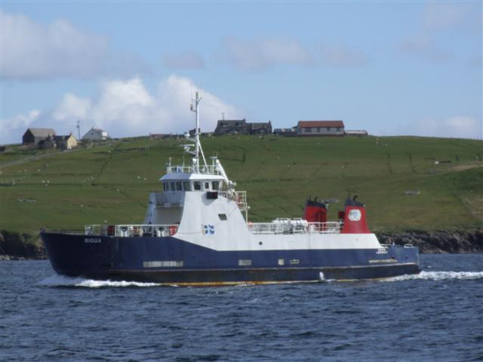
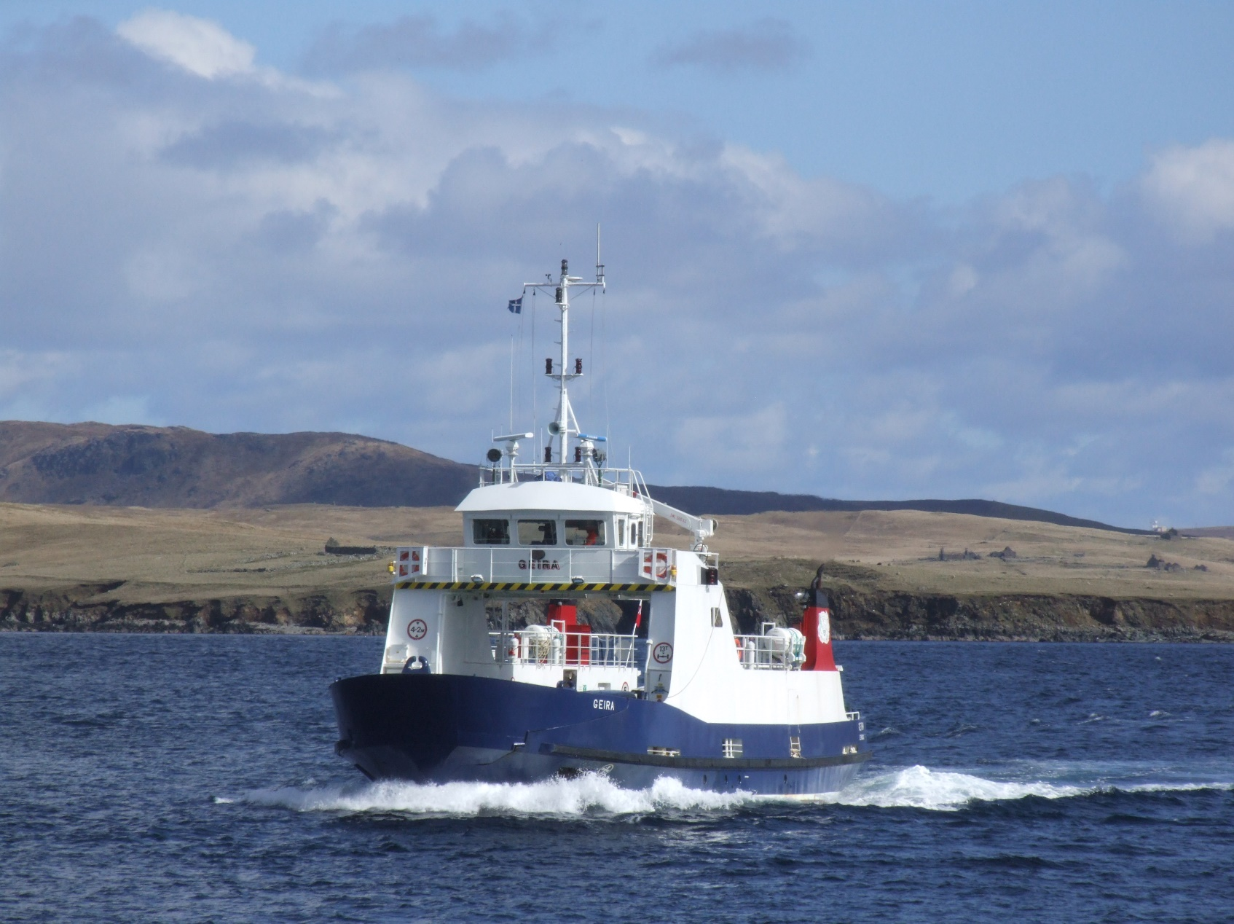
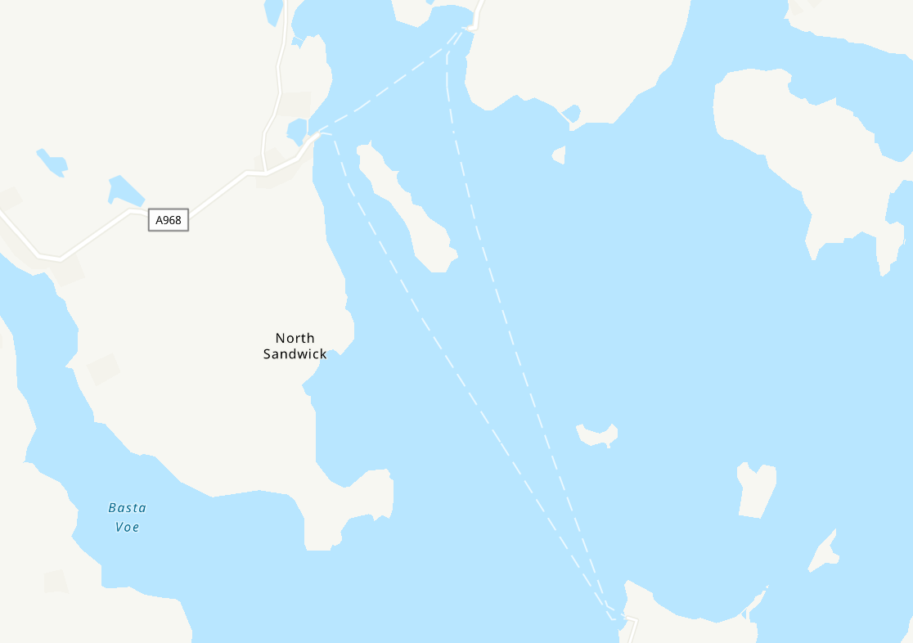
Vessel and Port Profiles
MV Bigga
Entered service: 1991
Passenger capacity (max): 96
Car capacity (Source: SIC): 14
Overnight berth: Gutcher, Yell
Other points of note:
Ageing vessel for which parts are becoming harder to source
Size of modern vehicles means that MV Bigga cannot routinely carry 14 cars
Passenger accommodation below the waterline
Limited cargo deadweight
MV Geira
Entered service: 1988
Passenger capacity: 96
Car capacity (Source: SIC): 10
Overnight berth: Hamars Ness, Fetlar
Other points of note:
Ageing vessel for which parts are becoming harder to source
Size of modern vehicles means that MV Geira cannot routinely carry 10 cars
Passenger accommodation below the waterline
It should be noted that all vehicles over 3.5 tonnes and special vehicles (e.g., dangerous goods) travelling between Gutcher and Belmont (and vice versa), must now be securely lashed (previously, this was at the Master’s discretion). This does not affect Fetlar sailings where lashing requirements have always existed
Belmont
Linkspan berth
Not used for overnighting
Gutcher
  Linkspan berth with short breakwater which allows MV Bigga to overnight there
  When MV Bigga is stood down for drills and maintenance for a period on a Monday, she berths at Cullivoe during this time
Hamars Ness
  Linkspan berth with dog-leg breakwater that allows MV Geira to lie there overnight
  The current ferry terminal was constructed in 2004

Slide 6


Timetable and Connectivity
Bluemull Sound timetable is delivered through:
  MV Bigga operating on a ‘shift’-basis. Her first departure from Gutcher is 06:10, with her sailing day finishing at around midnight if the last request sailing of the day operates. She operates seven days a week.
  MV Geira operates as the ‘day-boat’. She operates Monday – Saturday on a split shift basis:
    Winter (Tue-Fri): 06:55-09:20 and then 14:30-17:50
    Summer (Tue-Fri): 06:55-11:55 and then 14:30-17:50
  The break between shifts on a Monday is slightly shorter as MV Geira covers MV Bigga’s maintenance and drills
Winter and summer timetables are broadly the same, although the break between MV Geira shifts is around two and half hours less
The Bluemull Sound timetable will have to be amended to reflect the additional time now required to lash vehicles over 3.5 tonnes on the Gutcher – Belmont route leg
Indirect sailings (e.g., Gutcher to Hamars Ness via Belmont) add considerably to journey times
There are several late evening and Sunday morning request sailings which must be booked to operate. The 22:50, 23:05 and 23:35 request sailings will only operate four nights from any six, Monday to Saturday.
This graphic shows the winter departure times for scheduled ferry services from both Gutcher and Hamars Ness
Mon
*
Tue
*
Wed
*
Departing from Gutcher to H. Ness
Thu
*
Fri
*
Sat
*
Sun
Mon
07:00
08:00
09:00
10:00
11:00
12:00
13:00
14:00
15:00
16:00
17:00
18:00
19:00
20:00
21:00
22:00
23:00
*
*
*
Tue
*
*
*
Wed
*
*
*
Thu
Departing from H. Ness to Gutcher
*
*
*
Fri
*
*
*
Sat
*
*
*
Sun
*
*
*
= Indirect sailing
* = Request sailing
  The No.24 bus provides a through bus service from Gutcher (the embarkation point for the ferry to Fetlar and Unst) to Lerwick via the Yell Sound ferry. This is a single return service per day (Monday to Friday) which:
  Departs Gutcher at 08:40 (the closest arrival from Hamars Ness is the 07:55 via Belmont), travels on the 09:15 sailing from Ulsta and arrives in Lerwick at 10:26
  In the reverse direction, the bus leaves Lerwick at 14:20, travels on the 15:25 sailing from Toft and arrives in Gutcher at 16:12, connecting with the 16:15 sailing to Hamars Ness and 16:30 sailing to Belmont
  On Yell, the 24Y bus/dial-a-ride service (Cullivoe to Ulsta) provides a public transport connection between the Bluemull and Yelll Sound ferries:
  The 24Y does not however integrate well with Fetlar ferry services – it only connects with the following sailings from Gutcher: 10:05 (via Belmont); 16:15 (Monday)/16:40 (Tuesday to Friday); and the 18:55 (via Belmont)
  On a Saturday, the bus connects with the 10:05 and 18:55 services to Hamars Ness via Belmont
  On Unst, the No.28 operates from Belmont to Baltasound providing Unst residents with a connection to the Bluemull Sound services:
The Hamars Ness to Belmont ferry does not however connect particularly well with the No.28, which is more orientated around the busier Gutcher – Belmont route
The end-to-end journey time between Belmont and Baltasound is approximately 20 minutes
  There is a dial-a-ride bus service on Fetlar

Slide 7
Ferry Carryings, Capacity Utilisation and Performance
How many sailings are made on each leg in each year?
The figure shows the number of sailings made on each leg of the Bluemull Sound route.
The inter-island ferry service was subject to a programme of service reductions in 2013 – for Fetlar, the reductions were mainly focused on weekends.
There was a 2% reduction in scheduled sailings between Hamars Ness and Belmont and a much steeper 7% reduction in sailings between Hamars Ness and Gutcher between 2013 and 2015, and then broad stability thereafter.
A new timetable will need to be introduced to reflect the time required to lash all commercial vehicles over 3.5 tonnes travelling between Gutcher and Belmont, which will reduce the number of scheduled sailings.
The figure shows vehicle carryings in terms of total lane metres (LMs) carried on each leg of the Bluemull Sound route for each year between 2013 and 2024
A lane metre is a common unit of measurement for all vehicular traffic using a roll-on/roll-off (Ro-Ro) ferry. For example, a typical car would be 5 lane metres.
There is a degree of year-on-year variation on the Hamars Ness – Gutcher route, with around 30,000-35,000 LMs carried per annum. However, there was a significant reduction in carryings in 2019, which were 18% down on their 2013 level.
Carryings on the Belmont – Hamars Ness route leg remained stable (2015 aside) following the 2013 service reductions but declined quite significantly thereafter. Carryings in the last full pre-pandemic year were 19% below their 2013 level.
How have vehicle lane metre carryings changed over time?
How often are sailings full or nearly full?
Capacity is rarely an issue on Fetlar services. However, many Fetlar sailings are via another island, e.g., Gutcher to Hamars Ness via Belmont. This makes utilisation on the Gutcher – Belmont route important as it determines available capacity for Fetlar passengers.
The chart shows the proportion of direct Belmont – Gutcher sailings for each scheduled departure time where vehicle deck utilisation exceeded 75% - i.e., sailings which were full or nearly full in 2024.
There are several peaks across the day, with strong commuter flows to and from Unst.
To make a journey viable, the passenger has to be able to secure a booking in both directions.
How does this compare across time periods and routes? (2024)
The table on the right shows the proportion of total sailings within given time windows where vehicle deck utilisation exceeded 75% - i.e., sailings which were full or nearly full. It covers all Shetland Ro-Ro routes in the calendar year 2024.
Key headlines for Bluemull Sound include:
Around a quarter of weekday sailings between 07:00-19:00 on the Gutcher – Belmont route leg are full or nearly full
Similarly, around a quarter of Saturday and Sunday sailings on the Gutcher – Belmont route leg are also routinely full or nearly full
Capacity is not a significant problem on the Fetlar legs, although it does have to be borne in mind that the triangular nature of the route means that carryings on each leg are additive (so, for example, the 10:15 from Belmont routes via Hamars Ness, so the Fetlar traffic is additional to the Unst traffic, all of which has to be accommodated on the ferry)
 | Tuesday-Friday 0700-1900 | Monday 0700-1900 | Saturday 0800-1900 | Sunday 0900-1800 | Average (7 days, 0700-1900)
Bluemull: Fetlar –Unst | 2.1% | 2.0% | 5.0% | 1.8% | 2.1%
Bluemull: Fetlar-Yell | 2.5% | 3.5% | 4.5% | 4.7% | 2.9%
Bluemull: Unst-Yell | 24.2% | 23.9% | 23.5% | 26.9% | 23.8%
Bressay | 6.0% | 5.5% | 3.7% | 3.2% | 5.2%
Papa Stour | 2.0% | 1.0% | 0.5% | 0.0% | 1.4%
Skerries | 3.9% | 0.7% | 0.9% | 7.1% | 3.4%
Whalsay | 32.8% | 32.8% | 23.2% | 38.1% | 30.8%
Yell Sound | 13.8% | 14.3% | 21.6% | 13.9% | 14.3%
under 5%
5%-15%
more than 15%

Slide 8



Ferry Carryings, Capacity Utilisation and Performance
What was the impact of COVID-19?
2024 carryings as a proportion of 2019 carryings, Hamars Ness – Gutcher leg
The figure shows 2024 carryings as a % of 2019 carryings – i.e., how close has the route got to recovering from COVID-19?
Carryings on the Hamars Ness – Gutcher route leg were declining pre-COVID-19. Car carryings have however returned to their pre-pandemic level (standing at 99% of 2019 carryings) but passenger recovery has been slower, standing at only 92% of pre-pandemic carryings. CV traffic is much reduced.
The Hamars Ness – Belmont route leg (not shown in the graphic) has not fully recovered from the pandemic, with passenger and car carryings in 2024 standing at 90% and 92% respectively of their pre-pandemic level.
Passengers 92%
Cars 99%
Commercial Vehicles
(CVs)
77%
How has reliability changed over time?
Available cancellation data are patchy, but it suggests that there can be considerable year-on-year variation in cancellations.
However, it is evident that the longer and more exposed Fetlar route is subject to a much higher level of cancellation than the more sheltered Gutcher – Belmont route.
While the average for the route is shown in 2024, it should be noted that there were reliability challenges around crew availability.
The cause of cancellations is not always systematically recorded.
How often does the service operate to timetable?
Despite the relatively intense service and the multi-leg nature of the route, the majority of sailing legs (over nine in ten) on the Bluemull Sound route operated to timetable in 2024.
It should be noted that it only takes one of many sailing legs across the day to be late for the day overall not to operate to timetable.

Slide 9

Resident Survey Headlines
All Island Residents
Survey Headlines
Yell
18%
5%
blue badge holders
Car availability is high – 85% have access to a car for personal use
998 responses
Women accounted for 53% of responses
Whalsay
16%
Unst
15%
20%
National Entitlement Card holders
36% of isles employed adults work in mainland Shetland
Bressay
7%
Older age groups (65+) slightly under-represented
Fetlar
3%
Residents’ Use of Ferries
Car/Van (taken onboard, parked or dropped-off) accounts for between 80% and 92% of all ferry trips – with ‘car taken onboard’ the large majority of these
Around 40% of respondents said that there are occasions when they do not try and book because they know the ferry will be full
Unst + Fetlar
6 return trips per month on average
People most often book 2-3 days in advance
Whalsay + Yell
11 trips per month
Of those taking a car onboard, at least 85% of those in Fetlar, Unst, Whalsay and Yell say they book for ‘all or nearly all’ the sailings they make
Around 2/3 of respondents say that there are occasions when they have arrived without booking and have been unable to board the next ferry
15% of respondents said there are occasions when they do not travel at all if they cannot book onto their preferred sailing
Bressay
17 trips per month
Views of ferry services and their impact on island residents
People are typically least satisfied with:
Number of services cancelled at short notice
The service during refit periods
Early / late connections to the airport
Monday timetables (Yell Sound, Bluemull Sound, Whalsay)
Sunday service frequency
Facilities for those with a disability
Top factors limiting off-island travel:
Ability to book a vehicle onto preferred sailing
The number of service cancellations
Weekend service frequency
Activities which are being missed out on include:
Visiting friends and family
Other social activities
Shopping
1/3
of respondents said they travelled off their island less often than they would like because of the current ferry services
These people all noted a desire to travel more frequently if the issues they identified with the ferries were addressed
Mainland Residents
Mainland residents were asked about living in the isles
70% said the ferry service was a factor in their decision to leave
1/3 said they would consider moving back, with improved connectivity a major factor in making that happen
10% of those who have not lived in the isles would consider doing so
  90% of those said improved connectivity would encourage them to do so
1/3 had previously lived in the isles
The survey therefore revealed some appetite to move to/back to the isles if connectivity is improved

Slide 10
Resident Survey – Fetlar Headlines
Place of Employment
Main Reason for Journeys
Travel to Ferry
Vehicle Booking onto Ferry
The following sailings were identified as the ‘top 3’ most essential to book when travelling from Hamars Ness
07:55 (44%)
10:50 (20%)
06:55 (11%)
The majority of journeys on this route are made by car – 76% always/mostly take their car on the ferry
A further 6% of passengers use the bus on the ferry
6% also used community transport to complete their journeys
The following sailings were identified as the ‘top 3’ most essential to book when travelling from Gutcher
16:15 (13%)
17:15 (11%)
15:00 (10%)
In a typical month, how often are you unable to book onto your intended sailing?
Unable to book on a day (action)
Top 5 areas of satisfaction
(total percentage of people who indicate they are either satisfied or very satisfied)
Top 5 areas of dissatisfaction
(total percentage of people who indicate they are either dissatisfied or very dissatisfied)
Time of final sailing of the day [68%]
Time of first sailing of the day [64%]
Crossing time [62%]
Number of days per week ferry operates [57%]
Quality of ferry terminal facilities [56%]
Ability to return home from last flight [81%]
Ability to catch the first flight [79%]
Service during vessel refit periods [79%]
Service frequency – Saturday [72%]
Level of standard fares: commercial vehicles [71%]

Slide 11
Transport Problems
The case for any transport investment should be based on addressing a set of evidenced transport problems. We have developed a systematic ‘Transport Problems Framework’ to guide the development of this study, which is shown in the figure below.
Step 1
Establish and populate a transport problems framework for the study area
Step 2
Set out the supply-side root cause(s) of each identified problem
Step 3
Set out travel behaviour consequences of these problems
Step 4
Set out the societal consequences of travel behaviour choices
Step 5
Define a Transport Objective reflecting each transport problem(s), or groups of problems
A transport problem can be thought of in one of two ways:
  A problem experienced by a user or potential user of the transport network
  A negative impact imposed by the transport network on communities; poor air quality or noise for example
Transport problems, when thought of in this way, are typically associated with a relatively narrow range of parameters which define any journey, defined here as ‘problem themes’
We have highlighted what we understand to be the main transport problem themes for Fetlar in blue in the table on the right. Steps 1 and 2 of the ‘Transport Problems Framework’ are set out in the table below, and the outcomes of this engagement, together with other evidence, will be used to help inform Steps 3-5
All modes of transport | Public transport specific
Concern over the environmental impact of travel | Booking and journey planning
Cost of travel and affordability | Capacity – e.g., car deck capacity
Fuel and power issues | Comfort, safety and security
Integration of travel between modes (e.g., ferry to bus) | Connectivity and network coverage (i.e., availability of services)
Journey information, including for protected groups | Ease of use/convenience
Journey quality | Integration between services (e.g., bus-to-bus)
Journey times | Service reliability (cancellations and punctuality)
Journey time reliability | Timetables (time of first and last service, frequency and days of week operated
Lack of awareness of travel options
Personal accessibility
Personal security
Travel safety
Problem Theme | Problem(s) | Supply-side cause(s)
Concern over environmental impact of travel | Greenhouse gas emissions from vessels | MV Bigga and MV Geira are both conventional diesel vessels
Cost of travel and affordability | The level of fares was a source of dissatisfaction in the resident survey | High-frequency of travel means that the cost of travel can account for a high proportion of income
Integration of travel between modes – ferry to bus | Majority of ferries do not connect with a bus at Gutcher or Belmont – this is a particular issue for journeys to Lerwick given the need to connect with the Yell Sound ferry and then travel onwards from Toft | Limited and fragmented bus network High cost of bus service provision relative to demand Available buses generally focused on the higher volume Gutcher – Belmont route leg
Journey times | Extended journey times for indirect sailings. This is a particular issue in the ‘to Fetlar’ direction, where most sailings route via Unst | Requirement for two vessels to serve three islands – this is a particular issue when travelling to Fetlar as the majority of sailings are indirect
Personal accessibility | Physical accessibility to the passenger lounge on MV Bigga and MV Geira | Passenger lounge on both MV Bigga and MV Geira is below the waterline and only accessed by stairs
Booking and journey planning | Most Fetlar residents have to book sailings when taking a car – may not be able to get booking on preferred sailing and general ‘hassle factor’ | High vehicle deck utilisation on some indirect sailings (either via Gutcher/Belmont or where the ferry has called at Gutcher/Belmont first)
Capacity | Inability to secure a place on the ferry, either unable to get a booking or travel on demand when unbooked | Insufficient vehicle deck capacity at peak times, an issue which will be worsened by the new requirement to lash commercial vehicles on the Gutcher – Belmont route leg Little alternative to taking the car given very limited bus network and poor connections for Fetlar in particular
Service reliability (cancellations and punctuality) | Cancellations, particularly in 2024, were highlighted as a major source of dissatisfaction in the resident survey | Ageing vessels more prone to breakdown and, more recently, the requirement to lash commercial vehicles on the Gutcher – Belmont route Crew numbers/availability
Timetables | Some relatively long gaps in the timetable during the day One vessel service at the weekend One vessel service during refit Recent disruption to timetable Connections with first and last flights from Sumburgh One vessel service in the middle of the day on a Monday on Yell Sound | Limited resilience in fleet to cover refit Cost and crewing implications of operating the second vessel at the weekend Lower demand on a Sunday Requirement to lash all commercial vehicles over 3.5 tonnes in weight on the Gutcher – Belmont route means the published timetable cannot be operated Monday late morning/early afternoon used for drills and maintenance on Yell Sound
Step 1
Step 2

Slide 12




Questions and Answers
Q. Who is in the programme team?
Shetland Islands Council and advisers:
Stantec – Business case development and overall advisory lead
COWI – Fixed links lead
Mott MacDonald – Ferries and marine infrastructure lead
ProVersa – Supply-chain analysis
Q. Will this study progress a fixed link, ferry or harbour improvements to the point of construction?
No, it will identify a preferred option for each island and the future sequencing of investments (i.e., implementation) across the inter-island network.
Q. What will happen after a preferred option for each island is identified?
Work will commence (subject to funding) on individual, island-specific project business cases for each island’s preferred option, following the programme established by the agreed sequence of investments.
Q. Why is additional project business case work required for each individual island’s preferred option?
There are certain aspects about the viability, affordability and deliverability of each island’s preferred option that are typically managed more efficiently as individual projects. For example:
The development of detailed design proposals that take account of the constraints, risks and conditions for each individual island
Ground investigations for individual islands will be costly and, therefore, this expenditure should only be committed when required for individual projects
The identification of a procurement strategy that, while delivering best value to Shetland, is realistically achievable by the market in terms of capacity and experience
In addition, well-structured business cases are usually the key to positive funding decisions.
Q. Who makes the final decision on which project(s) goes ahead?
Decisions will be made by Shetland Island Council elected Members at three key decision points:
Decision Point 1 – the options to be taken forward for detailed appraisal
Decision Point 2 – preferred option for each island
Decision Point 3 – preferred sequence (and programme) of investments across the network, i.e., which individual projects are prioritised for delivery?
These decisions will be evidence-led and informed by analytical work based on guidance adopted by the Scottish and UK Governments, as well as further consultation and community engagement.
Q. When will I next be engaged with on this project?
We anticipate that the next round of engagement will take place in late Summer 2025. We will engage on the range of available options – ferry, harbour and fixed links – for each individual island and which of them should be taken forward for more detailed appraisal. This will support elected Members’ considerations at Decision Point 1.

Slide 13
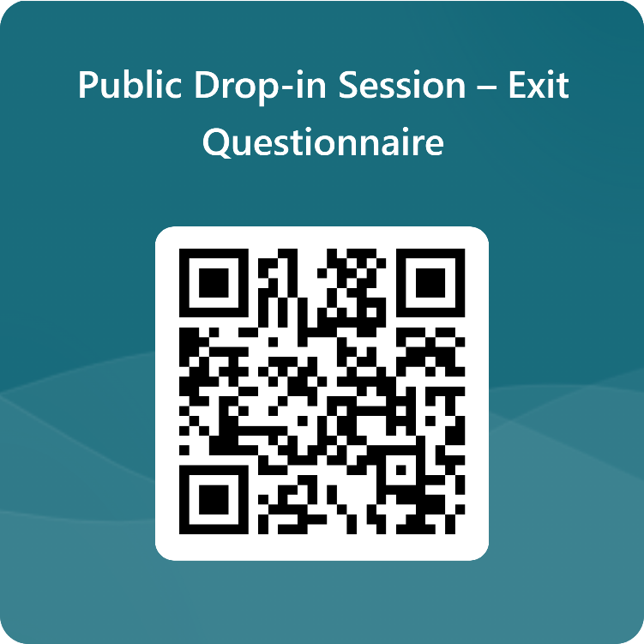
Next Steps
How will the outputs of this drop-in session be used?
The ‘case for change’ (or investment) is founded on the transport problems identified
These are used as the basis for setting out the ‘Transport Planning Objectives’, which are effectively a statement of the outcome sought from any investment and are used to appraise options
The discussions today, together with the outputs from the feedback forms, will be added to the wider body of evidence that we are developing to support the ‘case for change’
These will also allow us to sense check the data that we have presented, ensuring that it reflects the reality experienced by Fetlar residents when making journeys
What to do next
Please take this opportunity to provide your thoughts to the team on the material presented and ask any questions you may have
Does the information presented align with your experience of using the Fetlar ferry services?
The boards that you have just read provide some topics that you may wish to discuss, and we would be happy to hear any views that you may have
The display boards will also be published online at: www.shetland.gov.uk/iiTCShetland
Please also take the time to fill out the feedback form before you leave. It can also be found here: https://forms.office.com/r/zNbZDm7x8q

