Slide 1
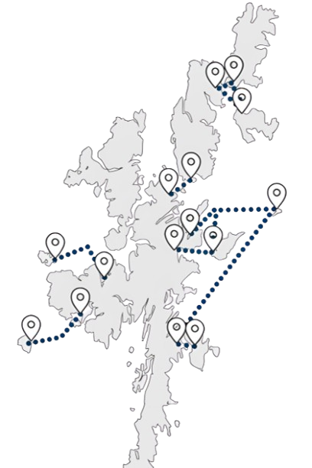











Inter-Island Transport Connectivity Programme
Whalsay Public Drop-In Session
1
2
3
  These two elements will be combined to create a ‘Network Strategy’, i.e., a sequential and costed investment plan for the inter-island transport network
We will achieve this by objectively and holistically determining:
The ‘case’ (in its widest sense) for fixed links
The shape of the ferry service and network in the short, medium and long term for all islands
6
This study will set out a long-term plan for Shetland’s island communities
5
The following boards set out:
Business case and decision-making process
Community engagement programme
Outputs and next steps of 2022 Whalsay OBC
Headline socio-economic data
Vessel and port profiles
Connectivity
Ferry carryings, capacity utilisation and performance
Resident survey - key headlines
Transport Problems Framework
Next steps and FAQs
4
Following the Strategic Business Case, the
Network Strategy Outline Business Case (OBC) will determine the preferred option for each of the islands and aggregate these to a preferred network option – i.e., which investments should be made, where and in which order?
  The network strategy will be developed in two stages
  Initially, the Network Strategy Strategic Business Case (SBC) will establish the case for investment, the Transport Planning Objectives and the ferry, harbour and, where appropriate, fixed link options at an island level

Slide 2






Network Strategy Strategic Business Case
1
2
3
4
‘Case for Change’
Route level option generation and development
Preliminary Options Appraisal
Programme Level Network Strategy SBC Report
The first step in the process is to set out the ‘Case for Change’ (CfC), which is currently under development. This establishes the rationale for intervention – i.e., why is investment required?
The CfC is being informed by extensive analytical work and engagement with communities, businesses and other stakeholders.
Ferry, harbour and, where appropriate, fixed link options will be developed for each island. At this stage, all potential options will be included for consideration.
This is primarily a qualitative process, designed to generate a shortlist of options for the detailed options appraisal in the OBC.
This appraisal will be undertaken on a route-by-route basis. A clear rationale for selection or rejection will be provided for all options.
Fixed link proposals for a minimum of Bressay, Fetlar, Unst, Whalsay and Yell will be retained for consideration at OBC.
Council Decision Point 1
‘Sign-off’ by elected Members on the options to be taken forward for detailed appraisal in the Network Strategy OBC.
Network Strategy Outline Business Case
5
6
7
8
Detailed Options Appraisal
Council Decision Point 2
Network options and sequencing
Council Decision Point 3
This part of the business case contains the key quantitative analysis and appraisal, undertaken in accordance with appraisal and business case guidance.
This will include but not be limited to the development of Benefit-Cost Ratios (BCRs), whole life greenhouse gas emissions comparisons, affordability and public acceptability.
Elected Members agree the preferred option for each island to be progressed into the Network Strategy.
Having identified preferred options at the route level, we will develop a range of ‘network option’ scenarios, which consider the timed sequence of investments and the implied costs, benefits and risks.
This will identify the priorities for project-level Outline and Full Business Cases and immediate next steps for the Council
Preferred network option –elected Members’ sign off on the preferred sequence of investments across the network
Network Strategy Programme Level OBC

Slide 3









Community Engagement
Network Strategy Engagement and Consultation Programme
1
2
3
4
Case for Change
Options Long List
Conclusion of Detailed Options Appraisal
Network Strategy
Understanding current travel behaviour and any problems with the current ferry service
January to March 2025
Engagement on the individual island options to be progressed to Detailed Options Appraisal
Summer 2025
Engagement on the outcomes of the options appraisal for each island
Winter 2025
Presentation of the final Network Strategy to communities around Council Decision Point 3
Winter 2025
Case for Change Engagement Activities
Online travel behaviour survey
Island resident, under-16 and businesses and mainland resident, under-16 and businesses
Public drop-in sessions
Community Stakeholder/User Group meetings
Youth engagement
Shetland Youth Voice, 14 January 2025 (with potential for follow-up events)
Scottish and UK Government
Informal liaison at present but a commitment to keep both governments informed
Council in-depth interviews
One-to-one in-depth interviews with officers across different Council services, e.g., Ferries and Economic Development
Stakeholder and business in-depth interviews
One-to-one in-depth interviews with business representative groups, major businesses and organisations that deliver services to the islands
Estate agent interviews
One-to-one in-depth interviews with some estate agents to understand the specifics of the property market in each island

Slide 4


How does this study relate to the 2022 Whalsay Outline Business Case?
The 2022 Whalsay OBC identified a phased approach to delivering the preferred option for Whalsay
Phase 1: Short-Term
  Proposal for a new vessel to replace MV Hendra – this remains a priority
  Built to operate on a number of routes and could be cascaded in the event of a fixed link being delivered
  Vessel to be accompanied by measures to improve travel choices to/from Laxo and Vidlin, e.g., improved bus services
  Phase 2: Medium-Term
  Business case to consider comparative merits of:
    Fixed link
    Two new 45-metre vessels and the redevelopment of the pelagic basin in Symbister Harbour
    Two new 45-metre vessels operating from North Voe
  The Inter-Island Transport Connectivity Programme Study will further develop and appraise these options

Slide 5








Headline Socio-economic Data
How has population changed over time?
Whalsay had a population of 966 at the 2022 Census.
Population has been fairly stable over a long time period – the chart shows that:
  Population in 2022 was 94% of its 1981 level
  Whalsay’s population did however reduce by 9% between 2011 and 2022
  This was a proportionally greater reduction than for Shetland overall, where the decline was much more modest
  Whalsay has an ageing population relative to mainland Shetland. In 2022:
  The proportion of the population aged 65+ was 27%, in 2022 compared to only 21% on mainland Shetland
  Whalsay also had a slightly smaller proportion of its population aged under-16 (18%) relative to mainland Shetland (19%)
  As a consequence, its working age population (16-64) is smaller at 55% of the population relative to 61% for mainland Shetland
  Whalsay’s ageing population has implications for service delivery on the island, the ability to fill island jobs and for resident travel demand.
What is the economic structure of Whalsay?
Note that Census data geography groups Whalsay and Skerries together
Whalsay has a strong presence in the pelagic and, to a lesser extent, whitefish sectors:
  Over a quarter of all resident jobs in Whalsay (i.e., jobs filled by island residents irrespective of whether they work in Whalsay) are in ‘Agriculture, Forestry and Fishing’
  This is also reflected in employee jobs by occupation with 31% employed in ‘Skilled Trade Occupations’, relative to the Shetland and Scotland averages of 19% and 12% respectively
  Commuting to jobs off-island is though essential:
    18% of all Whalsay adults in employment travel over 5km to work, which implies that they work off-island
    A further 31% responded ‘Other’ with respect to their distance travelled to work, a significant proportion of which will be in the fishing industry
    Levels of car ownership and car-based travel-to-work are well in excess of the Shetland and national averages
Agriculture, Forestry, Fishing
Health & Social Work
Transport & Storage
Education
Wholesale & Retail Trade
Public Admin & Defence
Manufacturing
Construction
Arts, Entertainment & Recreation
Professional, Scientific & Technical Services

Slide 6
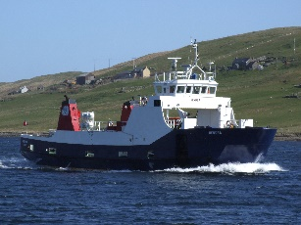
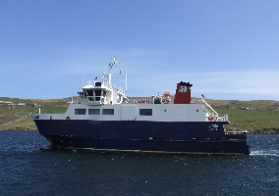
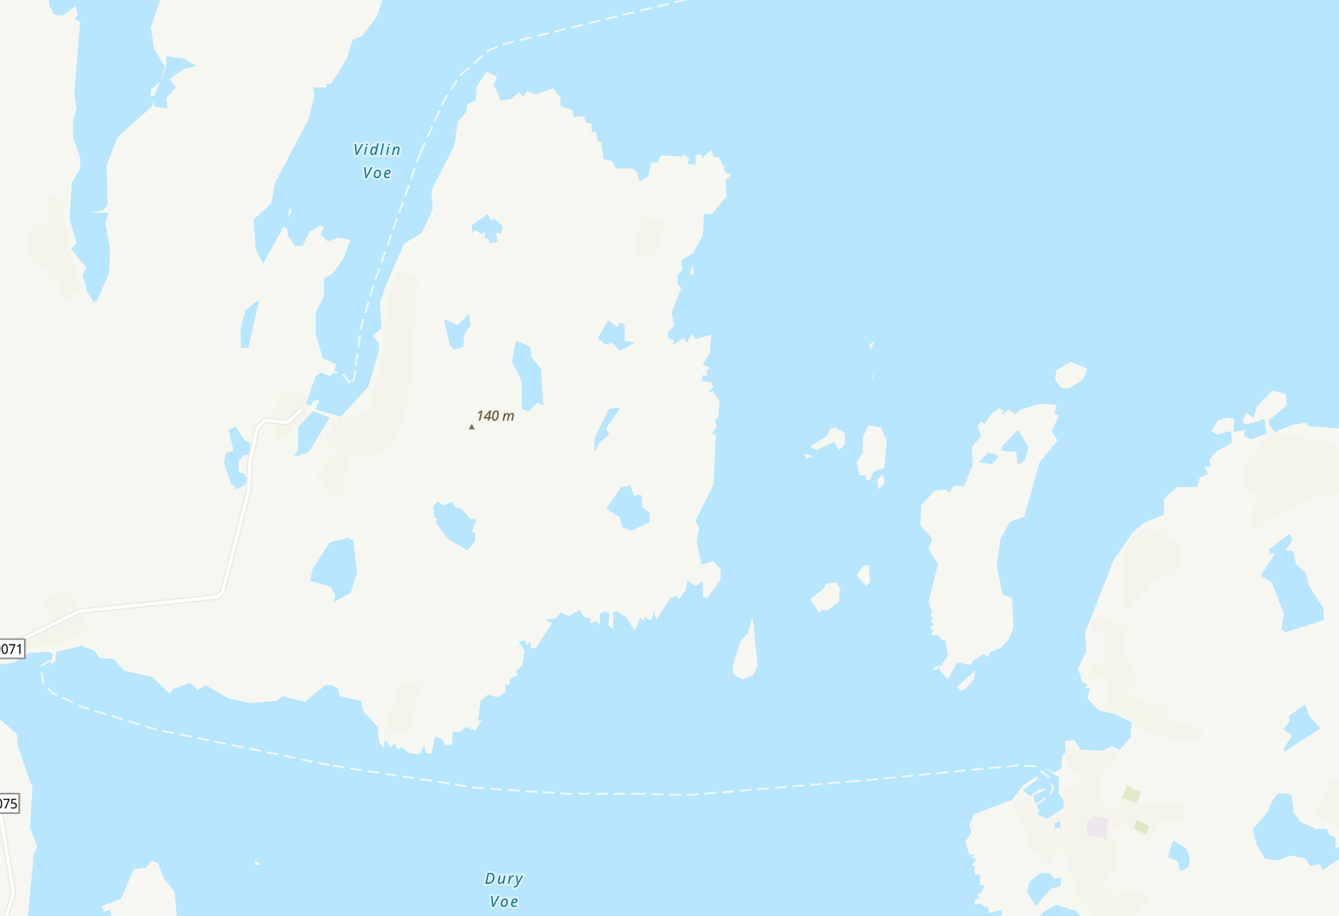
Vessel and Port Profiles
MV Hendra
Entered service: 1982
Passenger capacity (max): 95
Car capacity (Source: SIC): 12
Overnight berth: Symbister
Other points of note:
Ageing vessel for which parts are becoming harder to source
Size of modern vehicles means that MV Hendra cannot routinely carry 12 cars
Passenger accommodation below the waterline
MV Linga
Entered service: 2002
Passenger capacity: 95
Car capacity (Source: SIC): 18
Overnight berth: Symbister
Other points of note:
Size of modern vehicles means that MV Linga cannot routinely carry 18 cars
Vidlin
  Occasional diversionary port for the Whalsay service and principal mainland port for the Skerries service
Ferry terminal for Whalsay and overnight berth of MV Hendra, MV Linga and the Skerries vessel MV Filla
Mixed-use and spatially constrained harbour – the ferry has to operate around other harbour users, including the pelagic fleet
Narrow harbour entrance with strong cross-current – MV Linga towards the maximum size of vessel which can routinely and reliably operate from the port
Laxo
  Principal mainland port for the Whalsay service
  Route to Laxo affected by southerly/south-easterly winds, with Vidlin maintained as a diversionary port
Symbister

Slide 7
Diversions to Vidlin
How many days have at least one sailing diverted to Vidlin?
The number of days with a diversion to Vidlin varies by year but is generally around 3-4 days in every 10 on average. The number of sailing days with a diversion will generally be higher in winter.
How many sailings from Whalsay are diverted to Vidlin?
Only a small number of sailings are diverted to Vidlin, typically fewer than around 1-in-10 across the year

Slide 8


Timetable and Connectivity
Timetable is delivered through:
  MV Linga operating on a ‘shift’-basis. Her first departure from Symbister is 06:30, with her sailing day finishing at around 23:40. She operates seven days a week.
  MV Hendra operates as the ‘day-boat’. She operates Monday – Saturday from 07:00 to around 18:25
  MV Filla operates five sailings on the route on a Monday, allowing for drills and maintenance on MV Linga
  MV Hendra stands down for a period on a Saturday afternoon for her drills and maintenance
Winter and summer timetables are broadly the same
Most recent refit period (2025) saw a reduction to a single vessel – major reduction in connectivity
Sailing time to diversion port at Vidlin takes slightly longer, which can disrupt the timetable
Saturday timetable now broadly the same as a weekday (except for single vessel service in the middle of the day), following reintroduction of second vessel (withdrawn as part of the 2013 service reductions)
This graphic shows the departure times for scheduled ferry services from both Symbister and Laxo
Mon
*
Tue
*
Wed
*
Thu
*
Departing from Symbister to Laxo
Fri
*
Sat
*
Sun
*
Mon
07:00
08:00
09:00
10:00
11:00
12:00
13:00
14:00
15:00
16:00
17:00
18:00
19:00
20:00
21:00
22:00
23:00
*
Tue
*
Wed
*
Thu
*
Departing from Laxo to Symbister
Fri
*
Sat
*
Sun
*
= connecting bus service from Laxo
* = request sailing
Bus connectivity to/from Laxo and Vidlin is limited
No. 19 bus operates three return journeys between Viking Bus Station in Lerwick and Vidlin, Monday to Saturday
Only two of these services call at Laxo, both of which connect with an inbound and outbound ferry service
  There are no Sunday bus services
  The very limited bus service means that almost all users of the Whalsay service travel by car, either taking a car on the ferry or travelling as a foot passenger

Slide 9
Ferry Carryings, Capacity Utilisation and Performance
How many sailings are made by each vessel in each year?
The inter-island ferry service was subject to a programme of service reductions in 2013 – for Whalsay, the reductions were mainly focused on weekends.
There was a 5% reduction in scheduled sailings between 2013 and 2015, and then broad stability thereafter.
There were circa 700 additional sailings in 2023 relative to 2022, largely due to the restoration of a two-vessel service on a Saturday.
How have vehicle lane metre carryings changed over time?
The figure shows vehicle carryings in terms of total lane metres (LMs) carried for each year between 2013 and 2024.
A lane metre is a common unit of measurement for all vehicular traffic using a roll-on/roll-off (Ro-Ro) ferry. For example, a typical car is 5 lane metres.
There was growth in carryings between 2013 and 2016 but they were largely static thereafter – evidence from the Whalsay OBC suggests that travel is being constrained by vehicle deck capacity in the weekday peak periods.
How often are sailings full or nearly full?
The chart shows the proportion of Whalsay-Laxo sailings for each scheduled departure time where vehicle deck utilisation exceeded 75% - i.e., sailings which were full or nearly full in 2024.
In the ‘to Laxo’ direction, morning commuter and late morning sailings are the busiest, with the 09:15 routinely full or near to full.
In the ‘to Symbister’ direction, the evening commuter sailings are the most pressured.
To make a journey viable, the passenger has to be able to secure a booking in both directions .
How does this compare across time periods and routes? (2024)
The table on the right shows the proportion of total sailings within given time windows where vehicle deck utilisation exceeded 75% - i.e., sailings which were full or nearly full. It covers all Shetland Ro-Ro routes in the calendar year 2024.
Key headlines for Whalsay include:
Around one third of weekday sailings between 07:00-19:00 are full or nearly full
Despite the restoration of a two-vessel service on a Saturday, around one quarter of sailings are full or nearly full
The single vessel service on a Sunday also leads to nearly 40% of sailings being full or nearly full
 | Tuesday-Friday 0700-1900 | Monday 0700-1900 | Saturday 0800-1900 | Sunday 0900-1800 | Average (7 days, 0700-1900)
Bluemull: Fetlar -Unst | 2.1% | 2.0% | 5.0% | 1.8% | 2.1%
Bluemull: Fetlar-Yell | 2.5% | 3.5% | 4.5% | 4.7% | 2.9%
Bluemull: Unst-Yell | 24.2% | 23.9% | 23.5% | 26.9% | 23.8%
Bressay | 6.0% | 5.5% | 3.7% | 3.2% | 5.2%
Papa Stour | 2.0% | 1.0% | 0.5% | 0.0% | 1.4%
Skerries | 3.9% | 0.7% | 0.9% | 7.1% | 3.4%
Whalsay | 32.8% | 32.8% | 23.2% | 38.1% | 30.8%
Yell Sound | 13.8% | 14.3% | 21.6% | 13.9% | 14.3%
under 5%
5%-15%
more than 15%

Slide 10



Ferry Carryings, Capacity Utilisation and Performance
What was the impact of COVID-19?
2024 carryings as a proportion of 2019 carryings
Passengers 95%
The figure shows 2024 carryings as a % of 2019 carryings – i.e., how close has the route got to recovering from COVID-19?
The Whalsay route has largely recovered its pre-COVID position, with passenger and car carryings in 2024 standing at 95% and 104% respectively of their pre-pandemic level
Cars 104%
Commercial Vehicles (CVs) 96%
How has reliability changed over time?
Available cancellation data are patchy. The trend since 2019 has been a growth in cancellations but there is considerable variation within this and 2024 was not dissimilar to the period 2014 to 2019.
Note that the high rate of cancellations in 2020 and possibly 2021 is likely due to crewing issues/self-isolation during the pandemic.
The cause of cancellations is not always systematically recorded in the data.
How many days per year do the services operate to timetable?
The proportion of days when all sailings operated to timetable (the green line) varies year-on-year with no obvious trend or pattern in the data
However, around 9 in every 10 individual sailings (the blue line) typically operate to timetable, so there are high levels of reliability overall
The dip in 2020 is likely to be related to the pandemic

Slide 11

Resident Survey Headlines
All Island Residents
Survey Headlines
Yell
18%
5%
blue badge holders
Car availability is high – 85% have access to a car for personal use
998 responses
Women accounted for 53% of responses
Whalsay
16%
Unst
15%
20%
National Entitlement Card holders
36% of isles employed adults work in mainland Shetland
Bressay
7%
Older age groups (65+) slightly under-represented
Fetlar
3%
Residents’ Use of Ferries
Car/Van (taken onboard, parked or dropped-off) accounts for between 80% and 92% of all ferry trips – with ‘car taken onboard’ the large majority of these
Around 40% of respondents said that there are occasions when they do not try and book because they know the ferry will be full
Unst + Fetlar
6 return trips per month on average
People most often book 2-3 days in advance
Whalsay + Yell
11 trips per month
Of those taking a car onboard, at least 85% of those in Fetlar, Unst, Whalsay and Yell say they book for ‘all or nearly all’ the sailings they make
Around 2/3 of respondents say that there are occasions when they have arrived without booking and have been unable to board the next ferry
15% of respondents said there are occasions when they do not travel at all if they cannot book onto their preferred sailing
Bressay
17 trips per month
Views of ferry services and their impact on island residents
People are typically least satisfied with:
Number of services cancelled at short notice
The service during refit periods
Early / late connections to the airport
Monday timetables (Yell Sound, Bluemull Sound, Whalsay)
Sunday service frequency
Facilities for those with a disability
Top factors limiting off-island travel:
Ability to book a vehicle onto preferred sailing
The number of service cancellations
Weekend service frequency
Activities which are being missed out on include:
Visiting friends and family
Other social activities
Shopping
1/3
of respondents said they travelled off their island less often than they would like because of the current ferry services
These people all noted a desire to travel more frequently if the issues they identified with the ferries were addressed
Mainland Residents
Mainland residents were asked about living in the isles
70% said the ferry service was a factor in their decision to leave
1/3 said they would consider moving back, with improved connectivity a major factor in making that happen
10% of those who have not lived in the isles would consider doing so
  90% of those said improved connectivity would encourage them to do so
1/3 had previously lived in the isles
The survey therefore revealed some appetite to move to/back to the isles if connectivity is improved

Slide 12
Resident Survey – Whalsay Headlines
Place of Employment
Main Reason for Journeys
Travel to Ferry
Vehicle Booking onto Ferry
The following sailings were identified as the ‘top 3’ most essential to book when travelling from Symbister
9:15 (25%)
07:50 (22%)
08:30 (13%)
The majority of journeys on this route are made by car –
89% always/mostly take their car on the ferry
A further 11% always/mostly parked their cars at the terminal and travelled on the ferry as a foot passenger
Public transport use is negligible
The following sailings were identified as the ‘top 3’ most essential to book when travelling from Laxo
17:00 (27%)
17:55 (18%)
16:15 (6%)
In a typical month, how often are you unable to book onto your intended sailing?
Unable to book on a day (action)
Top 5 areas of satisfaction
(total percentage of people who indicate they are either satisfied or very satisfied)
Top 5 areas of dissatisfaction
(total percentage of people who indicate they are either dissatisfied or very dissatisfied)
Punctuality of the ferries (running to timetable) [71%]
Availability of suitable seating onboard [60%]
Check in times [65%]
Vehicle marshalling arrangements [57%]
Number of days per week ferry operates [54%]
Ability to get first flight [81%]
Service during vessel refit period [76%]
Facilities for those with a disability [71%]
Service frequency – Sunday [63%]
Ability to book vehicle on my preferred sailings [59%]

Slide 13
Transport Problems
The case for any transport investment should be based on addressing a set of evidenced transport problems. We have developed a systematic ‘Transport Problems Framework’ to guide the development of this study, which is shown in the figure below.
Step 1
Establish and populate a transport problems framework for the study area
Step 2
Set out the supply-side root cause(s) of each identified problem
Step 3
Set out travel behaviour consequences of these problems
Step 4
Set out the societal consequences of travel behaviour choices
Step 5
Define a Transport Objective reflecting each transport problem(s), or groups of problems
A transport problem can be thought of in one of two ways:
  A problem experienced by a user or potential user of the transport network
  A negative impact imposed by the transport network on communities; poor air quality or noise for example
Transport problems, when thought of in this way, are typically associated with a relatively narrow range of parameters which define any journey, defined here as ‘problem themes’
We have highlighted what we understand to be the main transport problem themes for Whalsay in blue in the table on the right. Steps 1 and 2 of the ‘Transport Problems Framework’ are set out in the table below, and the outcomes of this engagement, together with other evidence, will be used to help inform Steps 3-5
All modes of transport | Public transport specific
Concern over the environmental impact of travel | Booking and journey planning
Cost of travel and affordability | Capacity – e.g., car deck capacity
Fuel and power issues | Comfort, safety and security
Integration of travel between modes (e.g., ferry to bus) | Connectivity and network coverage (i.e., availability of services)
Journey information, including for protected groups | Ease of use/convenience
Journey quality | Integration between services (e.g., bus-to-bus)
Journey times | Service reliability (cancellations and punctuality)
Journey time reliability | Timetables (time of first and last service, frequency and days of week operated)
Lack of awareness of travel options
Personal accessibility
Personal security
Travel safety
Problem Theme | Problem(s) | Supply-side cause(s)
Concern over environmental impact of travel | Greenhouse gas emissions from vessels | MV Hendra and MV Linga are both conventional diesel vessels
Cost of travel and affordability | The level of fares was a source of dissatisfaction in the resident survey | High-frequency of travel means that the cost of travel can account for a high proportion of income
Integration of travel between modes – ferry to bus | Majority of ferries to/from Laxo/Vidlin do not connect with a bus | Limited and fragmented bus network High cost of bus service provision relative to demand
Personal accessibility | Physical accessibility to the passenger lounge on MV Hendra | Passenger lounge on MV Hendra below the waterline and only accessed by stairs
Booking and journey planning | Most Whalsay residents have to book sailings both ways when taking a car – may not be able to get booking on preferred sailing and general ‘hassle factor’ | High vehicle deck utilisation on peak sailings, booking required to guarantee travel
Capacity | Inability to secure a place on the ferry, either unable to get a booking or travel on demand when unbooked | Insufficient vehicle deck capacity at peak times, particularly on MV Hendra Little alternative to taking the car given very limited bus network
Service reliability (cancellations and punctuality) | Cancellations/diversions in south-easterly through southerly winds | Route alignment, although diversion port at Vidlin assists with reducing impacts
Timetables | One vessel service on a Sunday One vessel service during refit Connections with first and last flights from Sumburgh Understood that previous Saturday and Monday timetable issues have been addressed to some degree | Limited resilience in fleet to cover refit Cost and crewing implications of operating the second vessel on a Sunday Lower demand on a Sunday
Step 1
Step 2

Slide 14




Questions and Answers
Q. Who is in the programme team?
Shetland Islands Council and advisers:
Stantec – Business case development and overall advisory lead
COWI – Fixed links lead
Mott MacDonald – Ferries and marine infrastructure lead
ProVersa – Supply-chain analysis
Q. Will this study progress a fixed link, ferry or harbour improvements to the point of construction?
No, it will identify a preferred option for each island and the future sequencing of investments (i.e., implementation) across the inter-island network.
Q. What will happen after a preferred option for each island is identified?
Work will commence (subject to funding) on individual, island-specific project business cases for each island’s preferred option, following the programme established by the agreed sequence of investments.
Q. Why is additional project business case work required for each individual island’s preferred option?
There are certain aspects about the viability, affordability and deliverability of each island’s preferred option that are typically managed more efficiently as individual projects. For example:
The development of detailed design proposals that take account of the constraints, risks and conditions for each individual island
Ground investigations for individual islands will be costly and, therefore, this expenditure should only be committed when required for individual projects
The identification of a procurement strategy that, while delivering best value to Shetland, is realistically achievable by the market in terms of capacity and experience
In addition, well-structured business cases are usually the key to positive funding decisions.
Q. Who makes the final decision on which project(s) goes ahead?
Decisions will be made by Shetland Islands Council's elected Members at three key decision points:
Decision Point 1 – the options to be taken forward for detailed appraisal
Decision Point 2 – preferred option for each island
Decision Point 3 – preferred sequence (and programme) of investments across the network, i.e., which individual projects are prioritised for delivery
These decisions will be evidence-led and informed by analytical work based on guidance adopted by the Scottish and UK Governments, as well as further consultation and community engagement.
Q. When will I next be engaged with on this project?
We anticipate that the next round of engagement will take place in late Summer 2025. We will engage on the range of available options – ferry, harbour and fixed links – for each individual island and which of them should be taken forward for more detailed appraisal. This will support elected Members’ considerations at Decision Point 1.

Slide 15
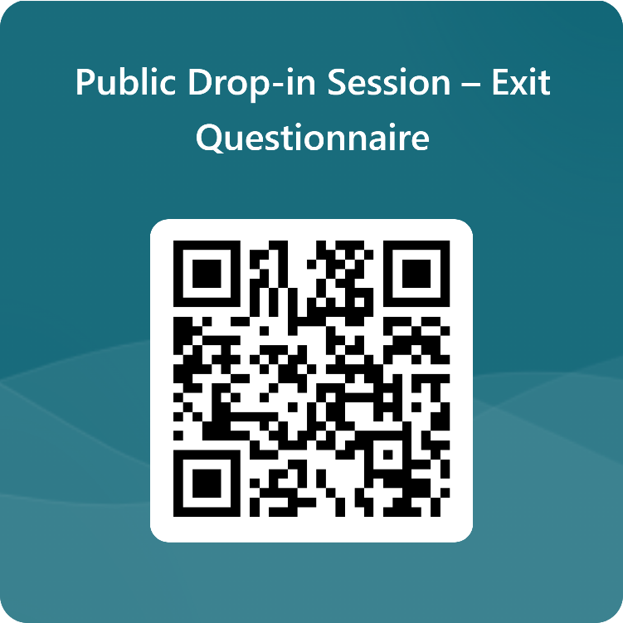
Next Steps
How will the outputs of this drop-in session be used?
The ‘case for change’ (or investment) is founded on the transport problems identified
These are used as the basis for setting out the ‘Transport Planning Objectives’, which are effectively a statement of the outcome sought from any investment and are used to appraise options
The discussions today, together with the outputs from the feedback forms, will be added to the wider body of evidence that we are developing to support the ‘case for change’
They will also allow us to sense check the data that we have presented, ensuring that it reflects the reality experienced by Whalsay residents when making journeys
What to do next
Please take this opportunity to provide your thoughts to the team on the material presented and ask any questions you may have
Does the information presented align with your experience of using the Whalsay ferry services?
The boards that you have just read provide some topics that you may wish to discuss, and we would be happy to hear any views that you may have
The display boards will also be published online at: www.shetland.gov.uk/iiTCShetland
Please also take the time to fill out the feedback form before you leave. It can also be found here: https://forms.office.com/r/zNbZDm7x8q

